Slide 1
THE ACT
TIPS, TRICKS, AND SKILLS PART 2

Slide 2
Don’t freak out….
While the act is not the most important thing in your entire life and is NOT the be-all and end-all of high school, it can be very helpful to you!

Slide 3
The ACT requires a very specific set of skills that you must master.
This presentation is designed to help you identify those skills so that you may STUDY AND PERFECT THEM!

Slide 4
What do you already know?

Slide 5
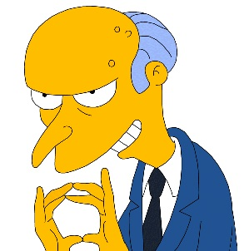
The ACT does not hide information from you!
It is not sneaky!
It is not a trick!
It tests the same skills over and over again!
Go to ACT.ORG to find out more information.
There are also many links on my porta portal (portaportal.com/guest/mcday)
YOU CAN STUDY!

Slide 6
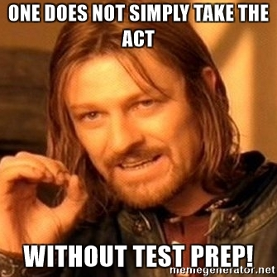
General Tips to Remember
It is NOT wrong to choose “no change.”
If you have two answers that are similar, choose the one that most closely resembles the original answer.
If you have two answers that are similar, choose the one with the least flowery language.
Always select standard written English.
Slang is always wrong.
Commas and dashes generally come in pairs.

Slide 7
ACT English- 45 mins/75 questions
BUT WHAT ARE THOSE SKILLS?!!
You are stranded on a desert island and you have only SEVEN skills to take along….
7 skills

Slide 8
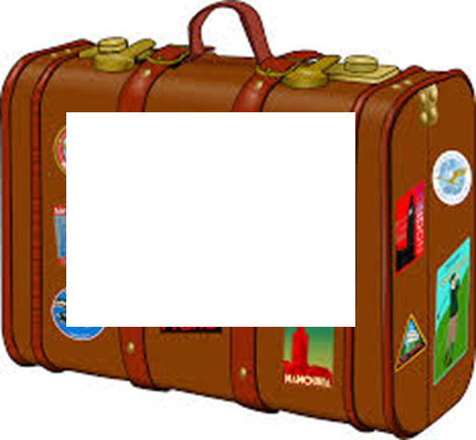
1. SENTENCE STRUCTURE
1. SENTENCE STRUCTURE

Slide 9
ACT English: Sentence Structure
There are NO ACT questions about simple sentences.
All are complex, compound, compound/complex, or involve extra phrases.
The ACT LOVES COMPOUND SENTENCES.

Slide 10
ACT English: Sentence Structure These are correct…
S= Complete Sentence DC= Dependent Clause (incomplete sentence)
S, CONJUNCTION S
S;S
S DC
DC, S S, DC
S.S

Slide 11
ACT English: Sentence Structure These are correct…
S= Complete Sentence DC= Dependent Clause (incomplete sentence)
The dog ate, but the cat slept.
The dog ate; the cat slept.
The dog ate. The cat slept.
The cat slept while the dog ate.
While the dog ate, the cat slept. The cat slept, although the dog ate.

Slide 12
ACT English: Sentence Structure The ACT likes to use INCORRECT structures…
S= Complete Sentence DC= Dependent Clause (incomplete sentence)
S, CONJUNCTION DC
S CONJUNCTION S
S,S
DC
DC S S DC
S S

Slide 13
ACT English: Sentence Structure The ACT likes to use INCORRECT structures…
S= Complete Sentence DC= Dependent Clause (incomplete sentence)
The dog ate, and slept. The dog ate and the cat slept.
The dog ate, the cat slept.
While the dog ate the cat slept. The cat slept although the dog ate.
The dog ate the cat slept
While the dog ate and the cat slept.

Slide 14
ACT English: Sentence Structure
Compound subjects and predicates
Subject and Subject predicate
Susie and Sally went to the store.
Subject predicate and predicate
The baby ate and slept.
NO COMMA

Slide 15
ACT English: Sentence Structure
The colon is not used to introduce a list on the ACT.
They needed to buy: hats, scarves, and gloves.
They needed to buy hats, scarves, and gloves.
They needed to buy the following items: hats, scarves, and gloves.
COMPLETE SENTENCE BEFORE LIST
NO PUNCTUATION

Slide 16
ACT English: Sentence Structure
INCOMPLETE SENTENCE BEFORE LIST
Translate a colon as “Now let me explain.”
If it makes sense, use it! If not- DON’T!
Every good outdoorsman must pack a: knife, matchbox, and water-resistant jacket.
Every good outdoorsman must pack three essential items: a knife, matchbox, and water-resistant jacket.
There was one thing stopping me from getting up on that stage: pure, unadulterated fear.
George W. Bush unwittingly summarized his entire presidential career in one unforgettable phrase: “They misunderestimated me.”
→ Notice the consistency with all the examples above: the clause which precedes the colon must be independent.

Slide 17
2. ELIMINATE WORDY EXPRESSIONS
1. SENTENCE STRUCTURE
2. Eliminate Wordy Expressions/Avoid Redundancy

Slide 18
ACT English
The shorter, the better!
CLEAR, DIRECT, AND CONSISE DICTION
CLEAR DICTION
NO FLUFF
The ACT hates long, fancy phrases and words. If they had to look a word up in the thesaurus, it’s probably not the answer.

Slide 19
2. ELIMINATE WORDY EXPRESSIONS
3. PICK THE EXACT WORD!
1. SENTENCE STRUCTURE
3. Pick the EXACT word! Good Diction Matters!

Slide 20
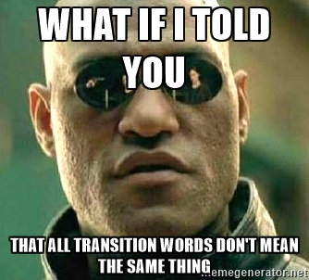
ACT English
Pay close attention to transitional words and phrases
Pay close attention to prepositions
The ACT LOVES transitions

Slide 21
ACT English
Know different transition families, and use them correctly.
“and”
Adds information (furthermore, additionally, etc…)
“so”
Causation (therefore, consequently, etc…)
“but”
Contrasts (however, nevertheless, etc…)

Slide 22
2. ELIMINATE WORDY EXPRESSIONS
3. PICK THE EXACT WORD!
1. SENTENCE STRUCTURE
4. Follow Directions PRECISELY!
4. FOLLOW DIRECTIONS
PRECISELY!

Slide 23
ACT English
The question is a set of directions to be followed EXACTLY.
The answer you choose should actually “Follow the Directions”
Note words such as “except”, “all”, etc.

Slide 24
2. ELIMINATE WORDY EXPRESSIONS
3. PICK THE EXACT WORD!
1. SENTENCE STRUCTURE
5. Subjects/Verbs
And
Pronouns/Antecedents
MUST AGREE
4. FOLLOW DIRECTIONS
PRECISELY!
5. SUB/VERBS
PRON/ANTEC.
MUST AGREE

Slide 25
ACT English
CLASSIC ACT QUESTIONS!
These are DESIGNED to throw you off.
The subject will be way early in the sentence.
There will be MANY extra words between the subject and verb.

Slide 26
ACT English
Objects of the preposition are never the subjects of a sentence.
If there is a phrase between the subject and the verb, cross it out to find the subject.
Changes for the new and improved ACT Writing section is going to be implemented soon.
Changes for the new and improved ACT Writing section is going to be implemented soon.
Changes for the new and improved ACT Writing section are going to be implemented soon.

Slide 27
ACT English
My sister, who is very social, were elected class president.
My sister, who is very social, was elected class president.
Carbonated beverages, which is delicious, are not good for your health.
Carbonated beverages, which are delicious, are not good for your health.
My boss, who is extremely kind to his employees, give helpful advice.
My boss, who is extremely kind to his employees, gives helpful advice.

Slide 28
ACT English
Review your singular and plural indefinite pronouns
Whoever has HIS/THEIR bag should get in line first.
Anybody who has HIS/THEIR papers turned in will earn an A.
Both students have HIS/THEIR charts complete.

Slide 29
ACT English

Slide 30
2. ELIMINATE WORDY EXPRESSIONS
3. PICK THE EXACT WORD!
1. SENTENCE STRUCTURE
6. Sound out ALL contractions
4. FOLLOW DIRECTIONS
PRECISELY!
6. SOUND OUT ALL CONTRACTIONS
5. SUB/VERBS
PRON/ANTEC.
MUST AGREE

Slide 31
ACT English
Do I need to explain?
It’s is “it is”
Its’ IS NOT A WORD
Let’s practice…
Who’s
They’re
You’re
Its’
Did I get ya?

Slide 32
2. ELIMINATE WORDY EXPRESSIONS
3. PICK THE EXACT WORD!
1. SENTENCE STRUCTURE
7. COMMA = PAUSE
4. FOLLOW DIRECTIONS
PRECISELY!
6. SOUND OUT ALL CONTRACTIONS
5. SUB/VERBS
PRON/ANTEC.
MUST AGREE
7. COMMA = PAUSE

Slide 33
ACT English
Make the pause pretty dramatic in your brain so that you can better do what “sounds right.”
Commas and dashes generally come in pairs.
Having too many commas is just as bad as not having enough.
IF A COMMA ISN’T NEEDED, DON’T USE IT.

Slide 34
ACT English
This one however, stuck in my mind forever.
This one, however, stuck in my mind forever.
The boys scanned a hungry, baby goat.
The boys scanned a hungry baby goat.
In the novel, To Kill a Mockingbird, Scout moves from innocence to experience.
In the novel To Kill a Mockingbird, Scout moves from innocence to experience.
PAIRS
INSERT LONG, DRAMATIC PAUSE HERE.
MANY PEOPLE DO THIS. IT’S WRONG.

Slide 35
Let’s Review!
You will need a sheet of copy paper and several sticky notes.
Write ONE tip or trick (not skill) on each sticky note. Try to use 3 words or less so that you put the tip or trick in your own words.
Many of the tips and tricks are related in some way.
Stick your notes onto your sheet of notebook paper clustered by their relationship to each other.
Be prepared to explain why you organized your sticky notes how you did.

Slide 36
Exit ticket
When analyzing your English test, what patterns did you notice emerge? How can knowing and understanding these patterns help you on your ACT? Explain.

Slide 37
ACT READING TEST TIPS AND TRICKS

Slide 38
Reading Test: 40 questions, 35 minutes
You're asked to read several passages and answer questions that show your understanding of:
what is directly stated
statements with implied meanings
Specifically, you will use referring and reasoning skills to:
determine main ideas
locate and interpret significant details
understand sequences of events
make comparisons
comprehend cause-effect relationships
determine the meaning of context-dependent words, phrases, and statements
draw generalizations
analyze the author's or narrator's voice and method

Slide 39
Four types of reading selections
Prose Fiction (25%). Questions in this category are based on intact short stories or excerpts from short stories or novels. A story
Social Studies (25%). Questions in this category are based on passages in the content areas of anthropology, archaeology, biography, business, economics, education, geography, history, political science, psychology, and sociology. Information: dry, dense– like a history textbook
Humanities (25%). Questions in this category are based on passages from memoirs and personal essays and in the content areas of architecture, art, dance, ethics, film, language, literary criticism, music, philosophy, radio, television, and theater.
Natural Sciences (25%). Questions in this category are based on passages in the content areas of anatomy, astronomy, biology, botany, chemistry, ecology, geology, medicine, meteorology, microbiology, natural history, physiology, physics, technology, and zoology. Like a science textbook

Slide 40
Organization of 4 Passages
They are always the same four types.
The four types are always in that same order.
The type of each passage is clearly labeled in bold print at the beginning of the passage.
Each passage will have 10 questions that accompany it.

Slide 41
Mastering the ACT: Reading Section
Rather than rushing through the four passages and performing poorly on the questions, give yourself more time for three passages and try to do a better, more thorough job on the questions for those passages.
Intentionally choose your favorite passages.
You do NOT have to read the passages in the order they are in the test booklet.
Choose your favorites to read FIRST, and read the one you dread LAST.

Slide 42
Mastering the ACT: Reading Section
For example, divide your time as follows:
Passage 1 (your favorite): 10 minutes
Passage 2: 10 minutes
Passage 3: 10 minutes
Passage 4 (Least favorite): 5 minutes

Slide 43
Mastering the ACT: Reading Section
TRY TO SCORE HIGH ON YOUR FAVORITE PASSAGES.
DO NOT GO OVER YOUR TIME LIMIT FOR EACH PASSAGE.
Jot down the starting times of each passage in your test booklet so you know when to move on.
DO NOT LEAVE ANY QUESTIONS BLANK.
For this to work, you must do REALLY REALLY well on the 3 favorite passages.

Slide 44
Mastering the ACT: Reading Section in 4 easy steps for your 3 favorite passages (10 minutes each)
Read just the first sentence.
Write in the top margin the time you must be DONE with the passage and questions. Remember: 10 minutes per passage!
Skim the questions first. It will help you understand the passage far better.
Skim or speed read the passage.
Read, answer, repeat for next passage.

Slide 45
Mastering the ACT: Reading Section in 4 easy steps for your least favorite passage (5 minutes)
Scan the questions for single line references. Answer those first.
Then, scan the passage. Answer questions as best you can.
With 30 seconds left, answer the same letter choice for all questions you have left.

Slide 46
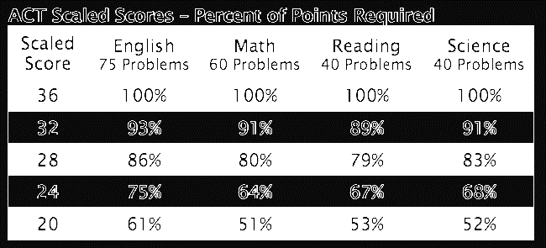
ACT Reading- 40 questions/35 mins
Implement your 10-10-10-5 time strategy.
But why?! How could that possibly work?
You must do well on your 3 favorite passages.

Slide 47
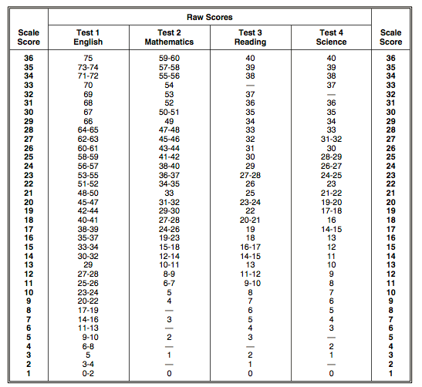

Slide 48
Reading Tips and Tricks
Skim through the questions, as it will help create an understanding of the passage.
When possible, “premark” the passage with question number (if line or section numbers are identified in the questions.
Read and underline/annotate the passage. You should always write as you read!
On the last passage you read, if you’re running short on time, you can just look at questions with line references and try to answer those questions without having to read the passage.
Never leave a question blank.

Slide 49
Common Question Types
Words in context
include the words infers, implies, or suggests
Main idea or purpose
Include the words least, most, not, except
Roman Numeral (combination answers)
Author’s purpose, tone, attitude
Sequence of events
Reasoning
Not required to read the passage

Slide 50
Reading Distractors: Answer Choices Designed to Distract you from the Correct Answer
Wrong answers that use the exact wording from the passage
Blending exact words or phrases into wrong answers
Wrong answers that refer to a true idea elsewhere in the passage
Wrong answers that are the exact opposite of the correct answer
Wrong answers that contain some element of truth- partially right or partially wrong
Wrong answers that are out of left field (easy to see)

Slide 51
Understanding Why
It is just as important to understand why an incorrect answer is wrong as it is to understand why a correct answer is right!
Why?

