Slide 1
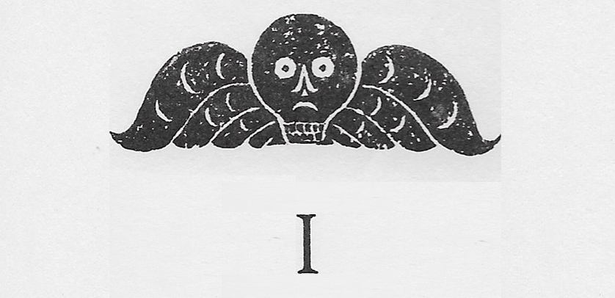
Beloved by Toni Morrison

Slide 2
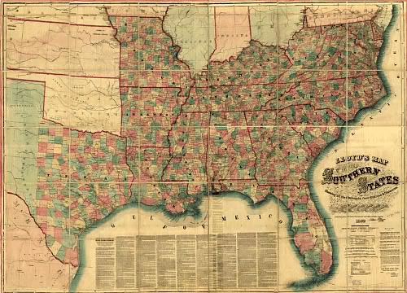
“Southern History”
Turn to “Southern History” by Natasha Trethewey on page 882 of Perrine.
Read the poem slowly and carefully.
When you finish, write a 5-8 sentence reaction to (not summary of) the poem.
Why does no one speak up about the lesson? What are the implications of silence from both students and teacher?
What lessons do we learn from the poem? What changes are we urged to make?

Slide 3
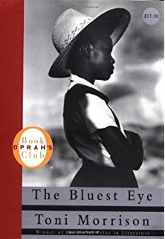
Toni Morrison
Toni Morrison desired to make those changes.
Morrison on why she decided to begin writing:
“I realized there was a book that I wanted very much to read, but it had not yet been written.”
This became her first work, The Bluest Eye (1970)
Sula (1973)
Song of Solomon (1977)
Tar Baby (1981)
Beloved (1987)- Nobel Prize winner
A Mercy (2008)
Home (2012)
God Help the Children (2015)

Slide 4
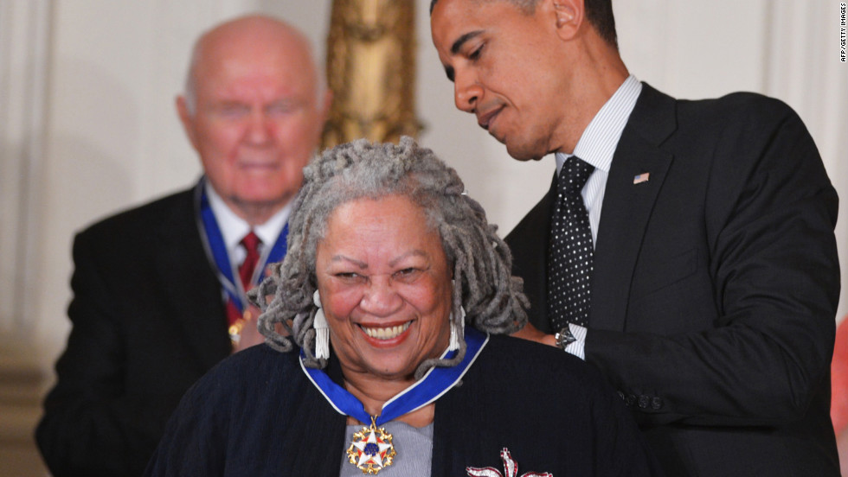
Why read Beloved?
Beloved is considered an “essential work of twentieth-century American Literature.
The New York Times considers Beloved “the best American novel published in the previous 25 years.”
Toni Morrison won a Novel Prize for Literature in 1993 and is the first black woman to be so honored.
Some consider Morrison America’s most important living writer and literary thinker.
Beloved caused a considerable stir among readers and literary critics due to its topic of slavery, as dealt with in a grueling and surrealist fashion.

Slide 5
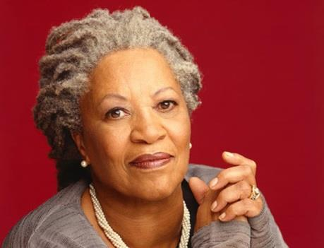
Toni Morrison Beloved
What are the benefits of studying a living author?
When Morrison reflects on her writing of Beloved, she reveals that it was an unpleasant realization that she would write a narrative about slavery. She says that it is “difficult to look at it from the outside.”
Brainstorm what this could mean.
To consider: What does Morrison look like? Sound like? What are your impressions of her?

Slide 6
Toni Morrison on Beloved

Slide 7
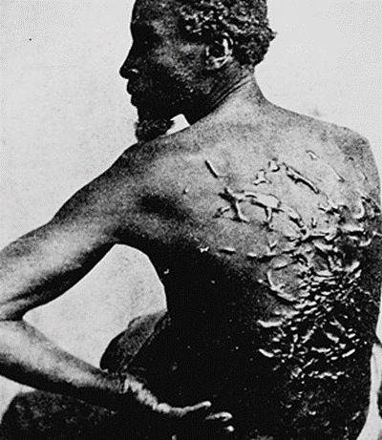
Toni Morrison on America and the Scars of Slavery
Although Morrison’s work has focused on the black experience (particularly of black women), she long avoided the subject of slavery.
It was considered taboo within her family and culture– too big, too traumatic, too embittering, too hard to face.
Morrison said that America too has willfully repressed the memory and shame of slavery, leaving millions of slavery’s victims “disremembered and unaccounted for.”
But the “ghosts of the dead,” as she refers to the millions lost to slavery, “haunted” her.

Slide 8
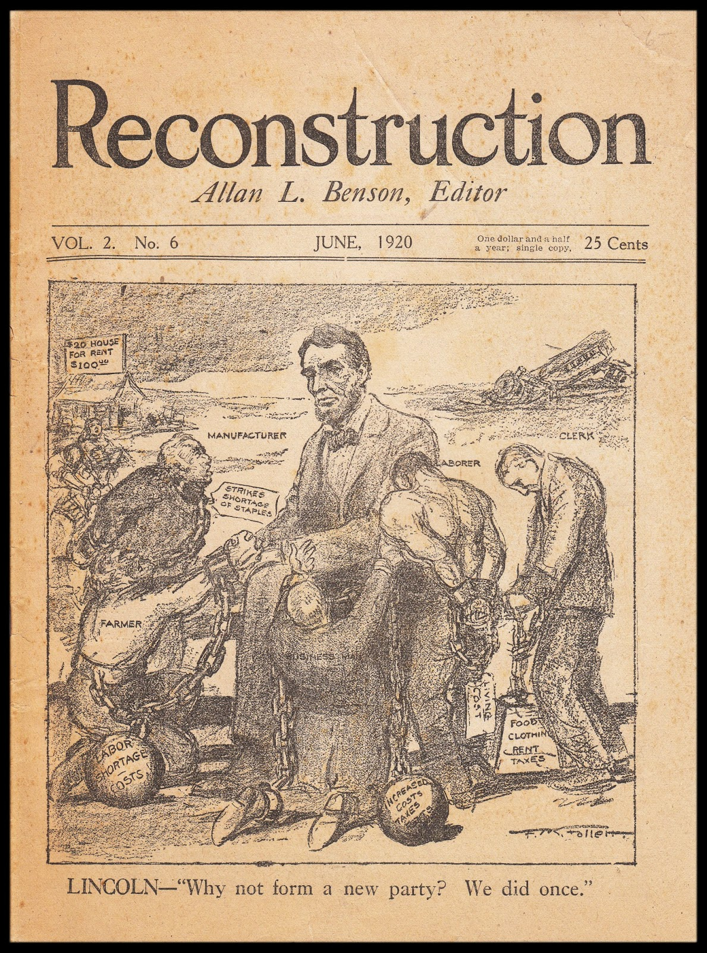
Beloved History
Events take place between 1854 and 1874
Encompasses the last days of the Civil War
Reconstruction era
Grounded in real world events
Margaret Garner, a runaway Kentucky slave, killed her daughter and attempted to murder her other children in order to spare them from an enslaved life.
Morrison did not research Garner or her life. She didn’t want the book to be a biographical study of one woman, or a novel about slavery, but rather a story about human interactions and the ways that people reacted to, survived, and lived in the wake of the horrible conditions of slavery.

Slide 9
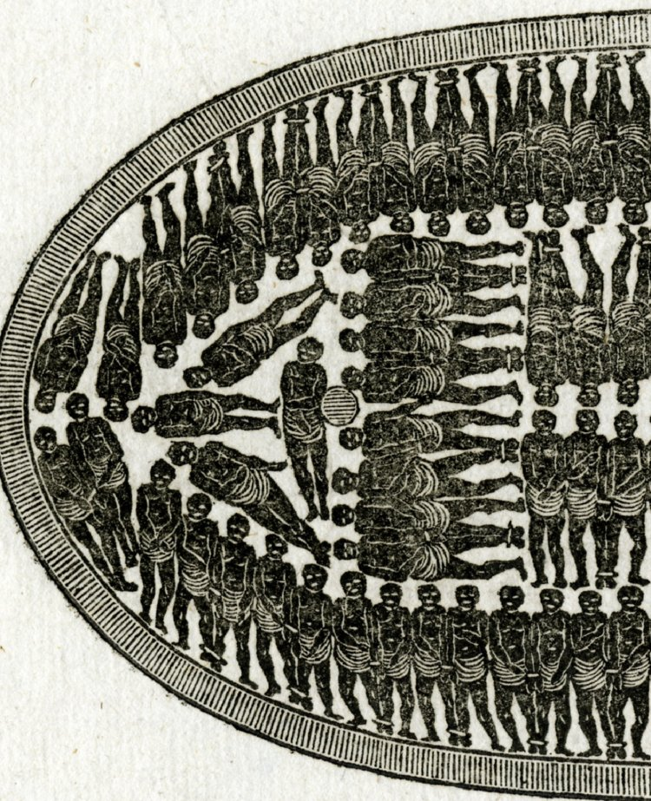
Slavery in America: An Unprecedented Brutality
In 17th Century Colonial America, slavery included white indentured servants, Native Americans, and African Slaves.
African slave trade: Mass captures and kidnapping—millions brought across the Middle Passage to the Americas.
In its scale and scope, slavery in 18th Century America becomes a soul-destroying brutality unprecedented in human history.
Slavery became a life sentence.
Worse yet, it became generational
Young women valued as breeding stock.
Loss of children, confiscated from mothers and sold at auction
Hundreds of thousands risked all to escape to North.

Slide 10
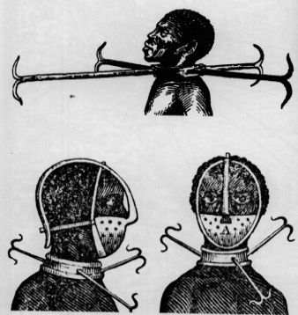
Morrison and Slavery
“There are no monuments to slavery.”
We have chosen to turn away and forget, once again denying the humanity, dignity and identity of the enslaved. Literature must be their monument and collective memory
Loving our country full means coming to terms with all of its past and heritage. To honor and remember the victims of slavery grants them their humanity and enriches our country.
Morrison creates a kind of collective memory/consciousness of slavery and the slave experience.
“Trying to make the slave experience Intimate.”

Slide 11
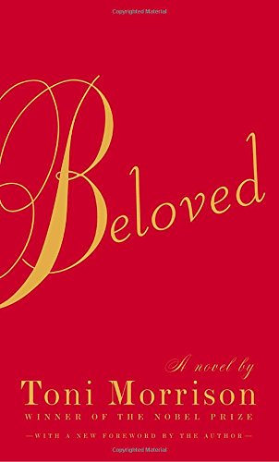
Morrison’s Intentions
Take a moment to read the Forward of Morrison’s masterpiece.

Slide 12
Ways of Reading Beloved
As a ghost story; a story about the haunting legacy of slavery on America, haunting of guilt
As a slave narrative—the brutalities and inhumanities of slavery from the intimate perspective of the enslaved
As a novel about motherhood and the intensity and complexity of maternal love and relationships
As a novel about love and relationships
As a novel about memory and history
As a novel about dealing with a traumatic past and trying to build a better future: Post Traumatic Stress Syndrome on both personal and national level.

Slide 13
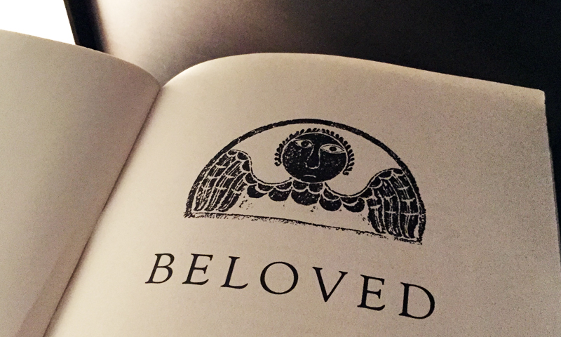
Language in Beloved
Morrison is an artist of the written word.
Ambiguity and uncertainty
Narrative structure
Changes in narrator
Sweet Home revealed piece by piece

Slide 14
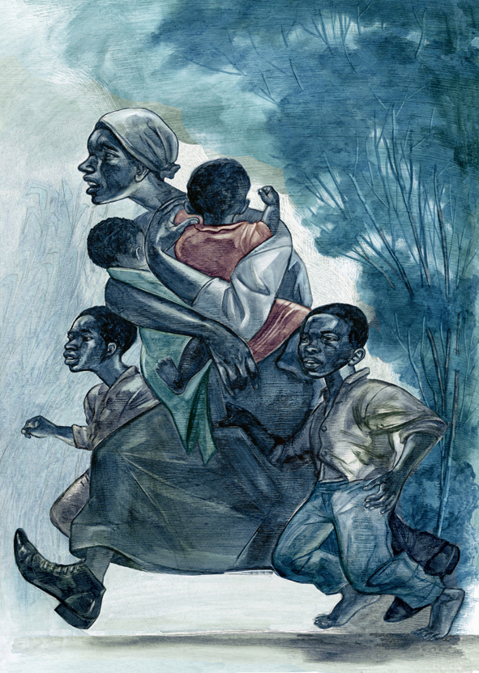
A Look at the Language
Take a moment to read the first two pages of Morrison’s masterpiece.

Slide 15
From Toni Morrison’s 1993 Nobel Lecture
“Language can never “pin down” slavery, genocide, war. Nor should it yearn for the arrogance to be able to do so. Its force, its felicity is in its reach toward the ineffable.
Be it grand or slender, burrowing, blasting, or refusing to sanctify; whether it laughs out loud or is a cry without an alphabet, the choice of word. The chosen silence, unmolested language surges toward knowledge, not its destruction. But who does not know of literature banned because it is interrogative; discredited because it is critical; erased because alternate? And how many are outraged by the thought of a self-ravaged tongue?
Word-work is sublime, she thinks, because it is generative; it makes meaning that secures our difference, our human difference- the way in which we are like no other life.
We die. That may be the meaning of life. But we do language. That may be the measure of our lives.”

Slide 16
Literary Techniques to watch for
Nonlinear structure: Interweaving of past and present in ways that go far beyond conventional use of flashbacks in literature.
Biblical allusions and religious overtones
Gothic novel re-imagined; ghosts and the supernatural
Symbols & motifs
Multiple, shifting narrative voices & points of view
Strange sort of collective consciousness or memory
Various rhetorical and literary devices; alliteration, anaphora, asyndeton, diacope, epistrophe, epizeuxis, metaphor, personification, simile, synecdoche, synesthesia, etc.

Slide 17
A Thought about Language
What is the role of language in our society?
Think about Morrison’s purpose in writing Beloved. Is it possible? Expand.

Slide 18
Don’t ask me how to pronounce the first one.
Epizeuxis: Repetition of a word or phrase in immediate succession, typically within the same sentence, for vehemence or emphasis.
“The horror, the horror!”
And thou no breath at all? Thou’lt come no more, Never, never, never, never!”
Diacope: Repetition of a phrase or word, broken up by other intervening words.
“To be or not to be…”
“You held me down, but I got up” You hear my voice, you hear that sound … You held me down, but I got up Get ready ’cause I’ve had enough I see it all, I see it now”
Synesthesia: a technique adopted by writers to present ideas, characters, or places in such a manner that they appeal to more than one sense, like hearing, sight, smell, and touch at a given time.
“You look cool.”
“Loud colors”
“Bitter silence”
“Warm colors”
“With blue, uncertain, stumbling buzz, Between the light and me; And then the windows failed, and then could not see to see.”
Asyndeton: the stylistic elimination of conjunctions between phrases.
“This is the villain among you who deceived you, who cheated you, who meant to betray you completely…”
“Consciousness of place came ebbing back to him slowly over a vast tract of time unlit, unfelt, unlived…”

Slide 19
To clarify
Epistrophe- repetition of words at the end of successive sentences.
“Then I’ll be all aroun’ in the dark. I’ll be ever’where – wherever you look. Wherever they’s a fight so hungry people can eat, I’ll be there. Wherever they’s a cop beatin’ up a guy, I’ll be there … An’ when our folk eat the stuff they raise an’ live in the houses they build – why, I’ll be there …”
Anaphora- the reverse of epistorphe- repetition of words and phrases at the beginning of successive sentences
“This land of such dear souls, this dear dear land”
“It was the best of times, it was the worst of times, it was the age of wisdom, it was the age of foolishness, it was the epoch of belief, it was the epoch of incredulity, it was the season of Light, it was the season of Darkness, it was the spring of hope, it was the winter of despair.”
Epizeuxis= repetition of words in succession within a same sentence for emphasis
“Alone, alone, all, all alone, Alone on a wide, wide sea.”

