Slide 1
Beloved Reading Section 2
Pages 125-195

Slide 2
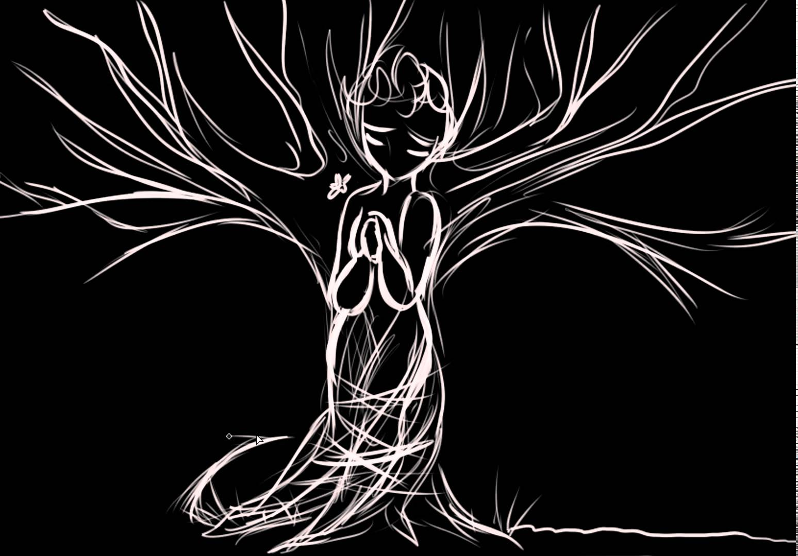
Reaction
What is your reaction to these chapters?

Slide 3
Reflection- Find/Be prepared to share/WRITE IT DOWN.
The most powerful line or passage, why it resonates to you, and its impact on the work as a whole so far.
Your most pressing/compelling question. (Yes, you must come up with one.)
A passage relating to past/present/memory OR some new imagery OR a repeating motif.
Critic Roland Barthes has said, “Literature is the question minus the answer.” What questions has the novel raised and to what extent does it answer them?

Slide 4
Snowball discussion
Share your personal reflections with a partner (3 minutes)
Join into a group of FOUR (4 minutes)
Join into a group of EIGHT (5 minutes)
We will then come together as a whole.

Slide 5
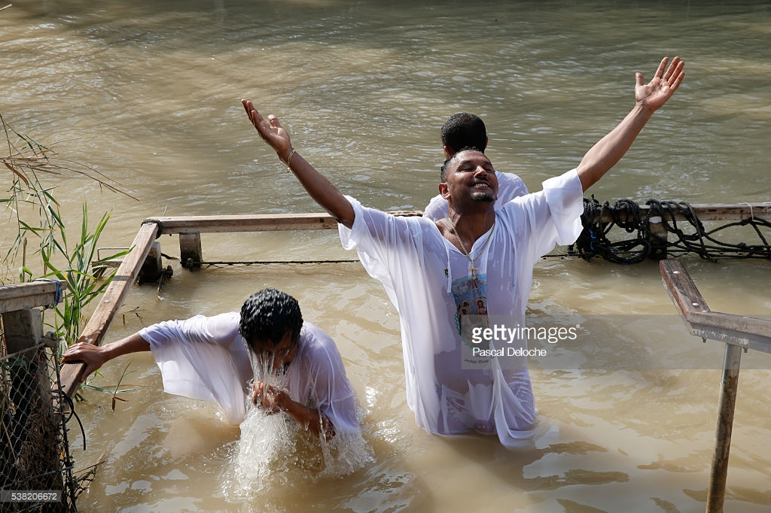
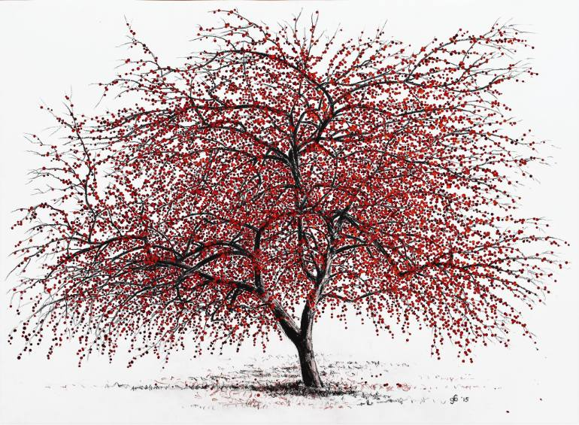
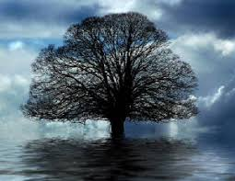
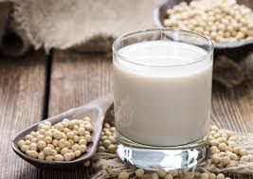
Motif and Archetype Notes

Slide 6
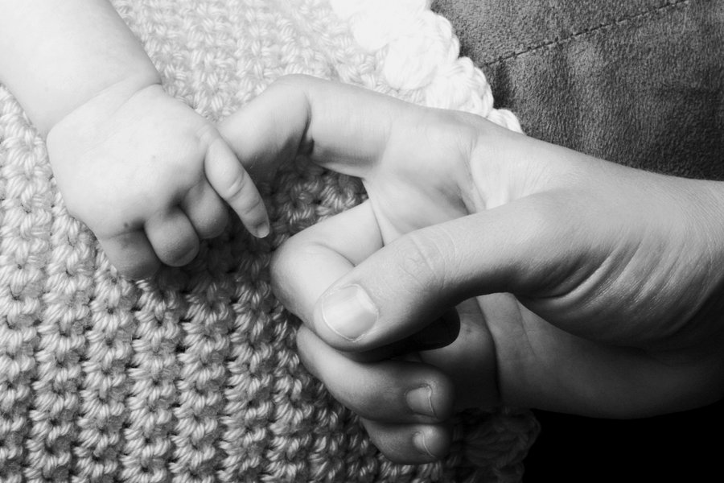
Motifs and Archetypes: Milk
Symbol for motherhood
Maternal instincts/the mother-daughter bond
Protection and provision for young
Nurturing
Act of nursing your own child is the only bonding and provision she could have as a slave
Sethe’s own mother isn’t able to nurse Sethe herself

Slide 7
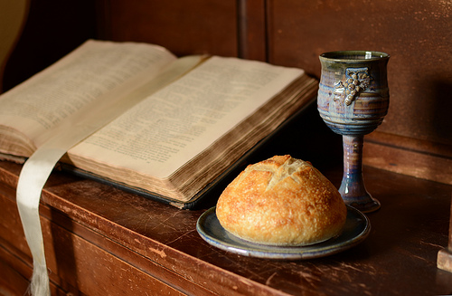
Motifs and Archetypes: Blood
Life itself
Divinity
Religious connotations: The blood of Christ/Bread and Wine as holy
Wine mixed with water/Blood mixed with water of the faithful to unite the blood of Christ and the Christian
The end of a cycle and the beginning of a new
Impure/dangerous

Slide 8
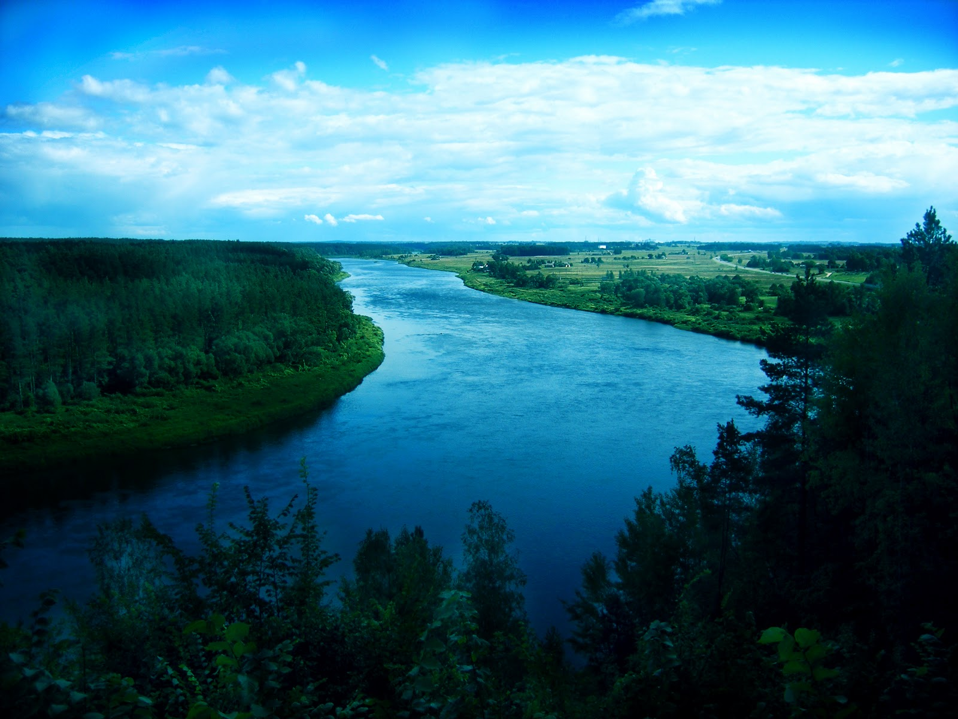
Motifs and Archetypes: Water/River/Rain
Life, cleansing, rebirth
Feminine
The mystery of creation
Spiritual mystery and infinity
A timelessness/eternity
River: death/rebirth (baptism), flowing of time into eternity, transitional phases of the life cycle
Rain: life giver

Slide 9
Motifs and Archetypes: Color
Red—love, sacrifice, hate, evil, anger, violent passion, sin, blood, disorder
Green—birth / death, fertility, luck, hope, jealousy, decay, greed
Blue—sadness, spiritual purity, truth, religious feelings of security
Orange– fire, pride, ambition
Black—before existence, death, the unconscious, darkness, mystery, primal wisdom, unconscious evil
White—purity, innocence, death, terror, supernatural, blinding truth

Slide 10
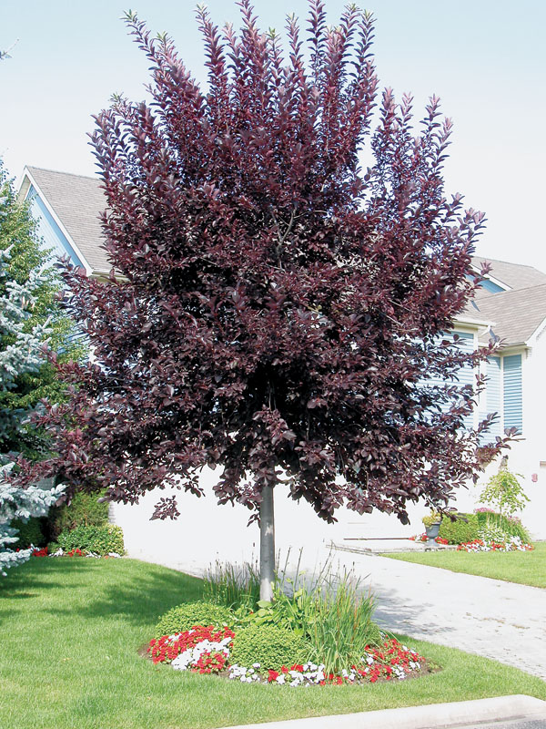
Motifs and Archetypes: Tree
Knowledge/learning
Tree of life
Tree of knowledge
Life, Death, Rebirth
Chokecherry Tree: permanent tree on Sethe’s back
Sethe can never see the tree on her back
White girl named it a “chokecherry” tree

Slide 11
Blood/Milk Motif
Who does Denver seem to choose to be loyal to? Beloved or Sethe? What is the significance of Denver drinking the blood of her sister and the milk of her mother? What does milk/blood symbolize? How does this action portray who she is loyal to?

Slide 12
Point of View
The story of the actual killing is told from the perspective of schoolteacher, the nephew, the slave catcher, and the sheriff (white characters). What is the effect of this POV on the story?
Why tell this part (and only this part) in this POV?
How would you characterize this POV in contrast to other POVs in the novel?

Slide 13
Point of View
The description of the murder of Beloved is told over the course of three chapters and from three different perspective. What is each character’s response to Sethe’s killing her child?
Schoolteacher
Stamp Paid
Sethe
What is Morrison’s purpose in presenting this single act from multiple viewpoints?

Slide 14
Character Motivation
In chapter 17, Stamp Paid tells Paul D. what happened in the wood shed.
HOW does he tell him, and how is the way that he tells him significant?
Why do you think he tells him? What is your reaction to him telling Paul?

Slide 15
Techniques and Meaning Paragraph Writing
Think about the meaning of the work as a whole addressing the themes of either community/isolation OR past/present/future.
At this point, what does the novel seem to be saying about one of these subjects?
How does the author’s use of imagery and motif develop this meaning of the work as a whole?
At this point, what questions remain about this subject?
Write
A paragraph with your argument and an explanation of how the images or motifs you’ve chosen develop your idea.
The questions you are left with (may be a list).
Imagery to Consider (Not limited to)
p. 23 Denver eating off the cracked plate
p. 33 the corn silk
p. 59 and 68 the shadows
p. 124 the turtles
p. 133 and 138 Paul’s tobacco tin/red heart
p. 133 Paul following the trees
Chapter 10—the chain gang chained together
Motifs to Consider (Not limited to)
• red/colors in general
• quilt
• trees
• water
• milk
• blood

Slide 16
A Look at Rhetoric- Use your Lit Techniques Quick Reference Sheet
Page 128 “They sang it out and beat it up, garbling the words so they could not be understood; tricking the words so that their syllables yielded up other meanings. They sang the women they knew; the children they had been; the animals they had tamed themselves or seen others tame. They sang of mosses and masters and misses; of mules and dogs and the shamelessness of life.”
Page 128 “Any they beat. The women for having known them and no more, no more; the children for having been them but never again.”
Page 132 “Alone, the last man with buffalo hair among the ailing Cherokee, Paul D finally woke up and, admitting his ignorance, asked how he might get North. Free North. Magical North. Welcoming, benevolent North.”
Page 160 “But the baby’s thrilled eyes and smacking lips made them follow suit, sampling one at a time the berries that tasted like church.”
Page 162 “Nothing seemed amiss– yet the smell of disapproval was sharp.”
Page 164 “But at Sweet Home there wasn’t a rice field or tobacco patch in sight, and nobody, but nobody knocked her down. Not once.”
Page 187 “She was spinning. Round and round the room. Past the jelly cupboard, past the window, past the front door, another window, the sideboard, the keeping-room door, the dry sink, the stove– back to the jelly cupboard.”
Page 190 “Covering the lower half of her face with her palms, she paused to consider again the size of the miracle; its flavor.”

