Slide 1
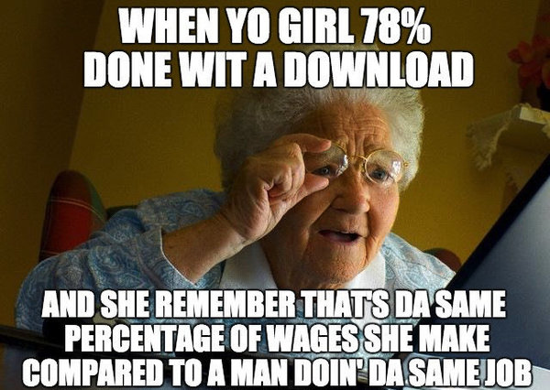
#GirLPoWeR
Reversal of Roles in Jane Eyre

Slide 2
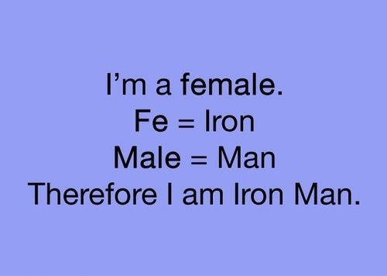
Jane gaining autonomy
Running away from passion (Rochester)
Teaching Job
Family
Inheritance
Refusing a marriage proposal (multiple times)
Returning to Rochester on her own

Slide 3
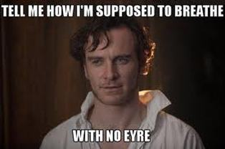
The icing on the cake. . .
Even after all the ways Jane already exerts her independence. . .
BRONTE MAKES ROCHESTER GO BLIND!!!
How does taking away Rochester’s eyesight impact Jane’s relationship to him??

Slide 4
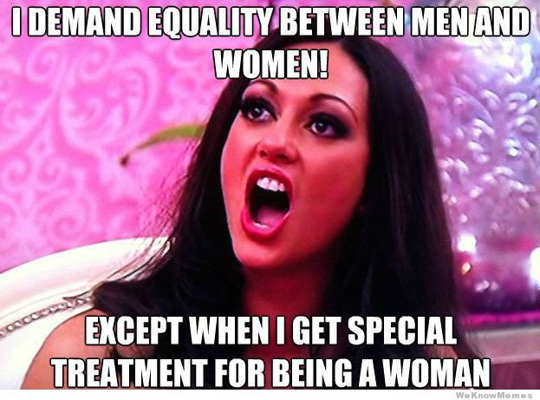
Feminist Literature
https://www.youtube.com/watch?v=fzbLLMOmxcg

Slide 5
Feminist literature cont.
In 1855, nearly eight years after the publication of Jane Eyre, it was read as a feminist manifesto, at a time when married women had no existence in law and no property or divorce rights; women could neither vote nor enter the universities or the professions. Jane Eyre considered a rabble-rousing document whipped up a generation of women writers to grossness and violence. There was a threatening of patriarchal family and state. Such reactions came from the self-asserting character of Jane herself. “I care for myself. The more solitary, the more friendless, the more unsustained I am, the more I will respect myself.” Her mutiny against her master and social class showed her desire to be treated like a human rather than a machine doing its part. She demands to know from Rochester. .”Do you think I am an automaton?- a machine without feelings?” she claims herself as an equal and demands self-worth (of course with her fair share of struggles)

Slide 6
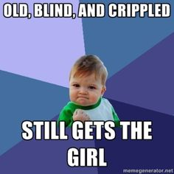
A reversal of roles
“Then he stretched out his hand to be led. . .I served as both his prop and guide.”

Slide 7
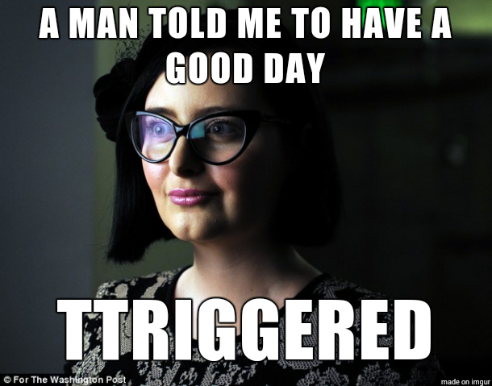
#Girlpower moments
Your groups task is to find the most powerful moment where Jane exerts her independence, reverses the roles of men and women, where she has #GIRLPOWER
DIRECTIONS:
Find at least three moments you feel could be the most powerful and I will come and approve one of them.
Then, one of your group members will log into a laptop and go to mdlivingston.weeble.com. Under the JANE EYRE tab there is a button where you will find your block’s powerpoint to work on.
Find your slide and create a small presentation about the most powerful moment your group decided on. You will then present to the class and I will choose the winner who argued the best that their moment is the MOST POWERFUL!!

Slide 8
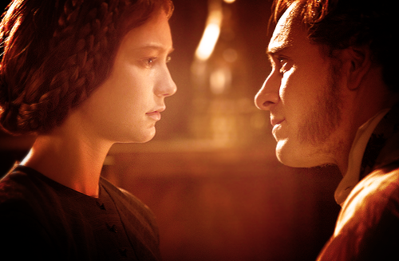
The ending scene
https://www.youtube.com/watch?v=pAMknGDjCAo

