Slide 1
Hamlet Act IV, Scene v
Flower Power

Slide 2
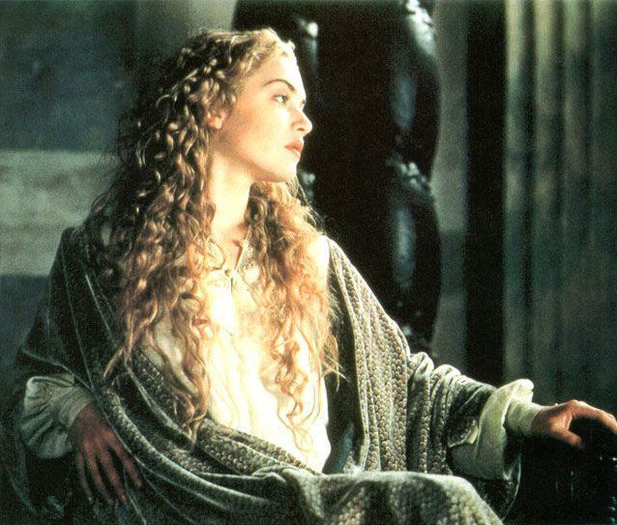
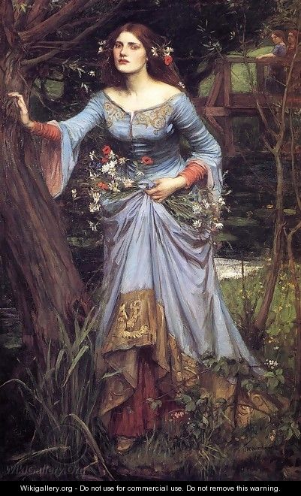
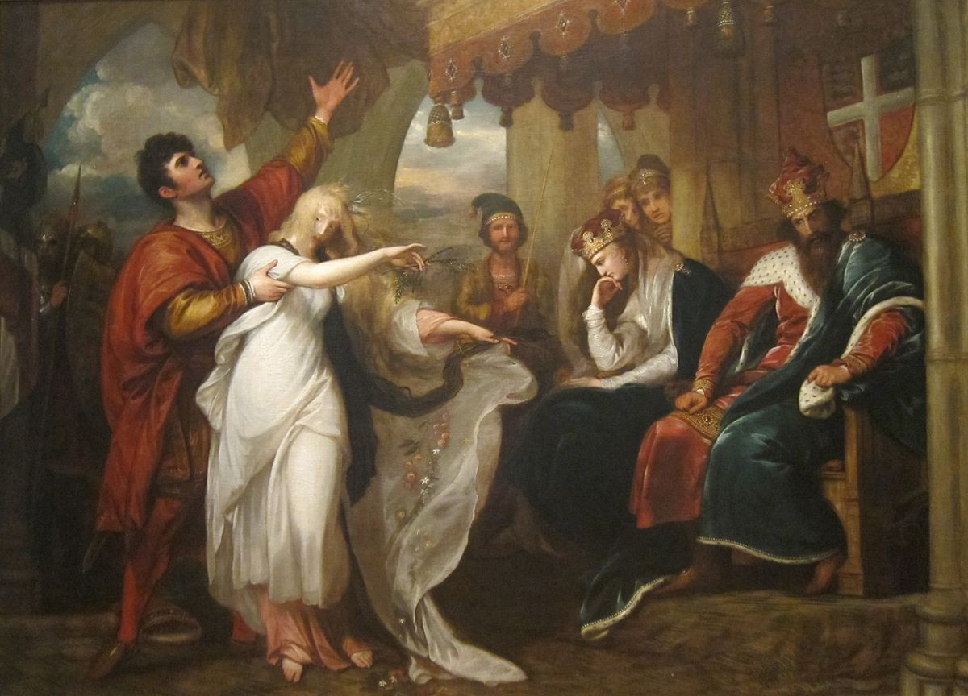
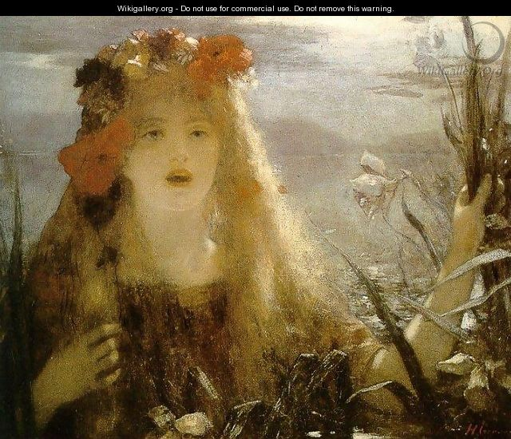
“O rose of May, dear maid, kind sister, sweet Ophelia!”

Slide 3
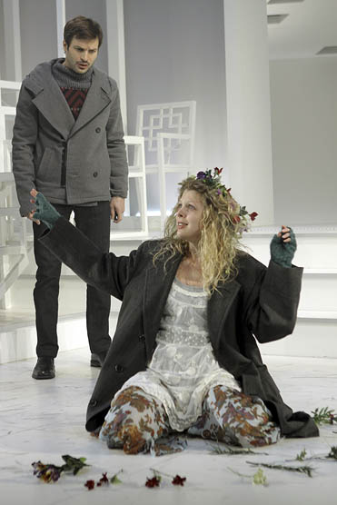
“The poison of deep grief”
Why has Ophelia gone mad?
What does she have to say about her father’s murder?
Paraphrase her lines in Scene v to reveal the truths found within.

Slide 4
Ophelia’s Bouquet—
Flower Symbolism
Though she seems mad, Ophelia reveals certain truths through flower symbolism in Scene v.

Slide 5
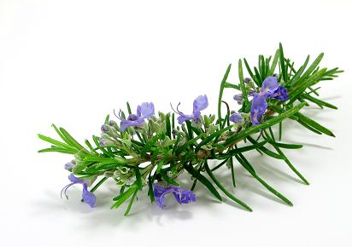
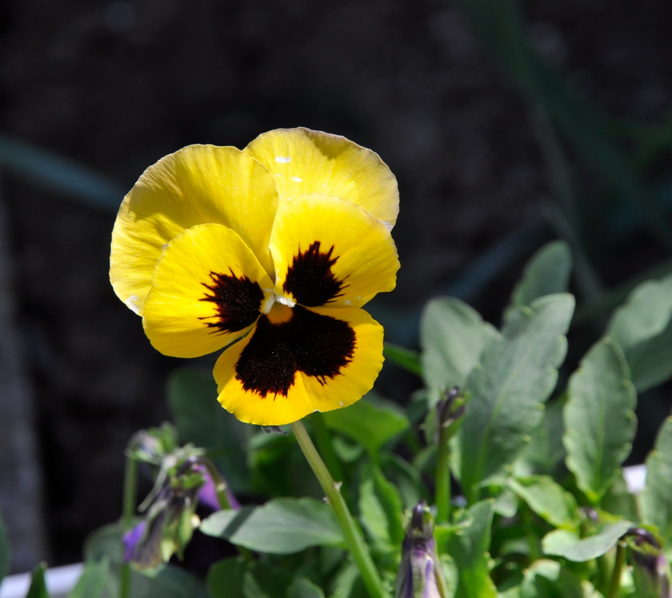
Flower Symbolism—
To Laertes
Rosemary: the symbol for remembrance and faithfulness
Pansy: the symbol for thoughts and faithfulness
What is the significance of rosemary as a gift for Laertes?
What should he remember?

Slide 6
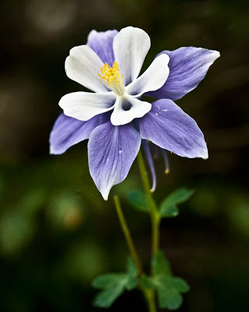
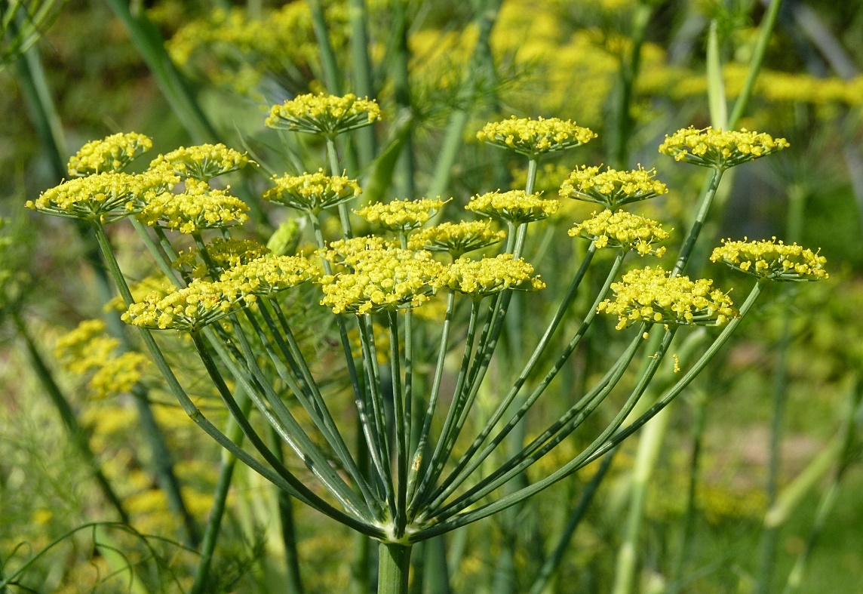
Flower Symbolism—
To Claudius
Fennel: the symbol of flattery and deceit
“Sow fennel, sow sorrow.”
Claudius loved to be flattered, so he would view the fennel first as flattery. Combined with Columbine, however, is a different story …
Columbine: the symbol of male adultery, ingratitude, and faithlessness; the emblem of deceived lovers
Shakespeare’s audience would have known the fennel to mean flattery and the columbine to mean adultery and foolishness because of the order of the gifts. Also, fennel would wilt quickly once picked.
What risk does Ophelia take here?

Slide 7
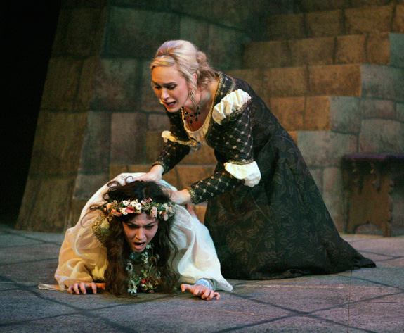
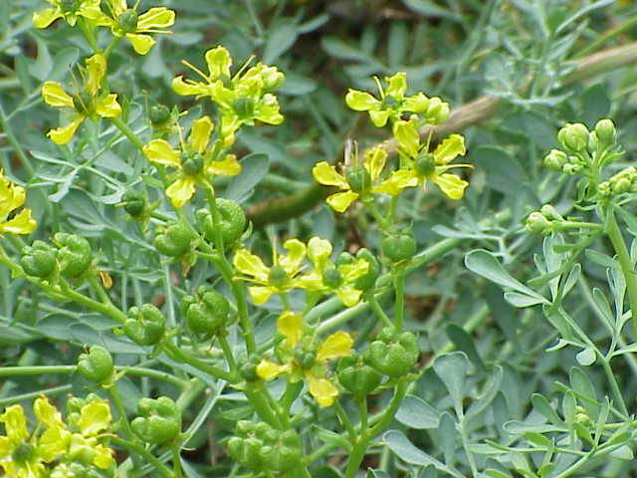
Flower Symbolism—
To Gertrude
Rue: the symbol of adultery; the symbol for genuine repentance of all transgressions for women; the symbol for everlasting suffering
Rue is very bitter
Ophelia walks over to the queen and says, “There’s rue for you, and here’s some for me. We may call it herb of grace a Sundays. O, you must wear your rue with a difference.”
Rue was used to induce abortions in its day, which is why it was tied with adultery.
Ophelia insults the king and queen to their faces in front of witnesses

Slide 8
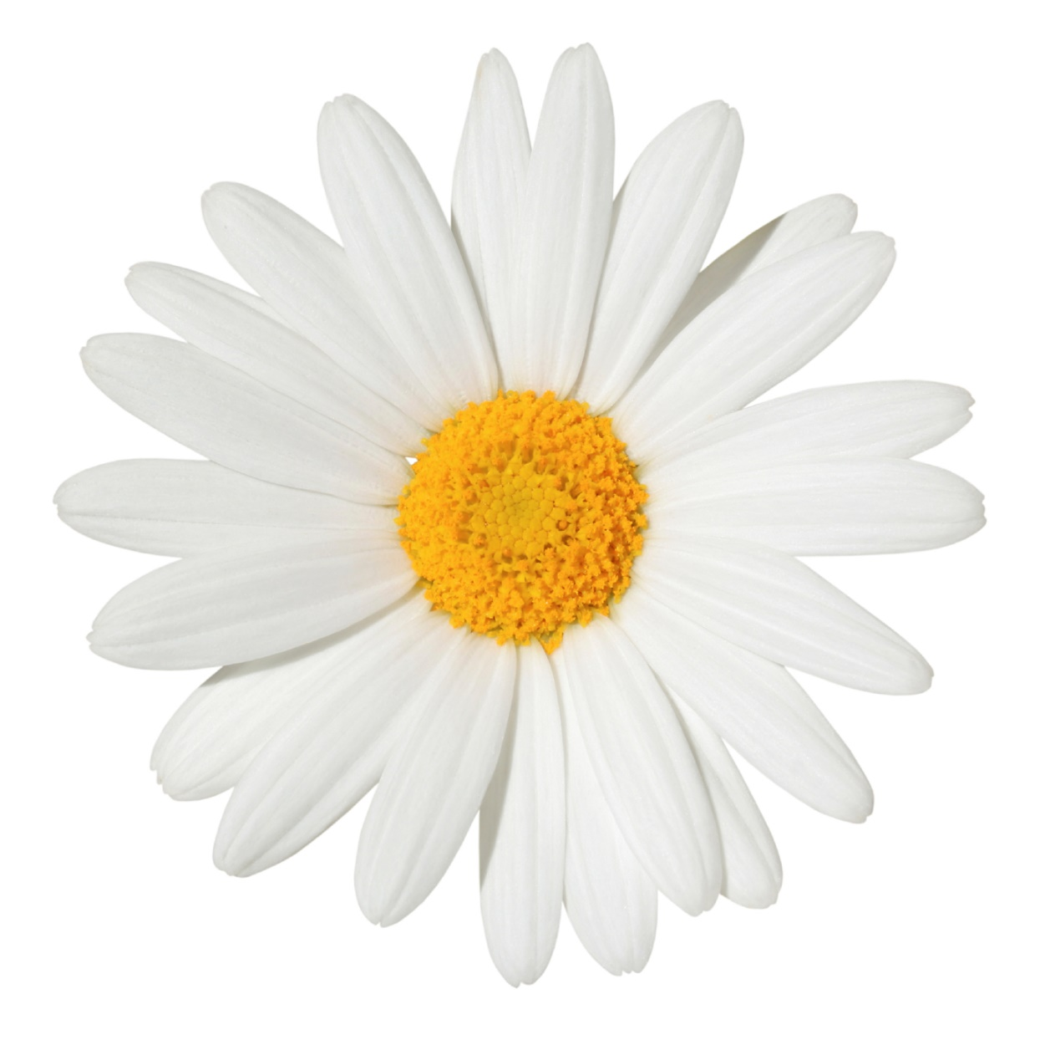
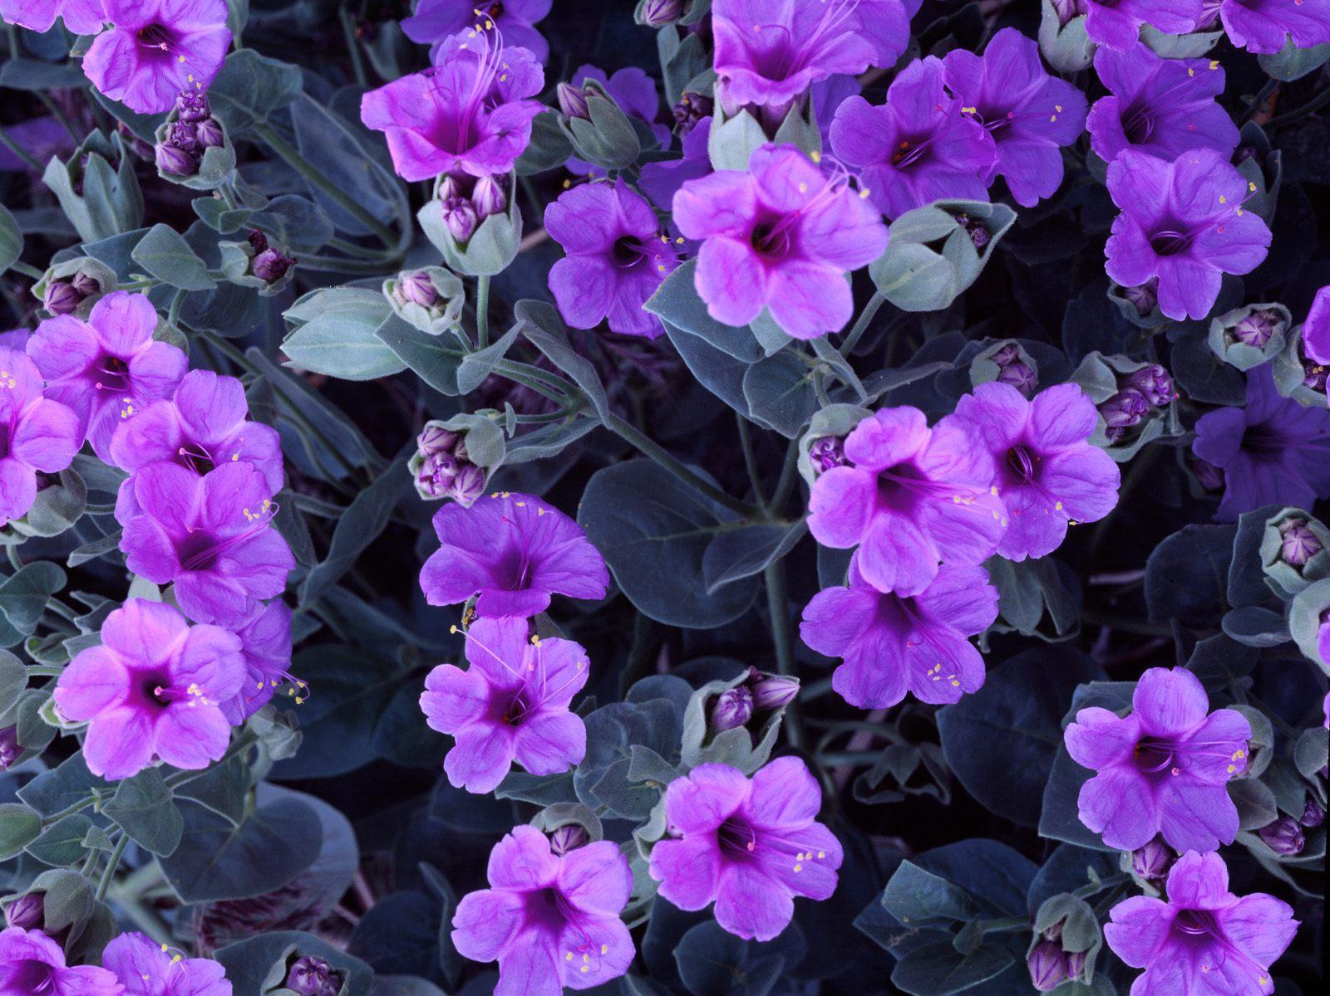
Flower Symbolism
Daisy: the symbol for innocence
What does Ophelia do with the daisy? What could it mean?
Ophelia then sees a daisy and says, “There’s a daisy.” She picks it up, looks sadly, and then puts it back. In effect she is saying, “There is no innocence here.”
Violet: the symbol for faithfulness or fidelity
Then Ophelia says, “I would give you some violets, but they wither’d all when my father died.”
So what is she telling the king and queen?
What is she saying about their faithfulness and integrity?

Slide 9
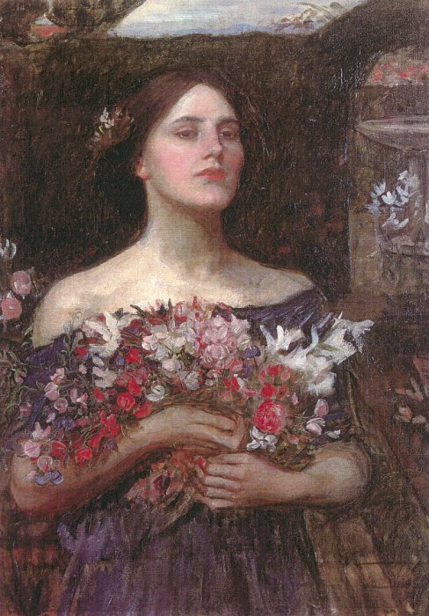
Ophelia’s Bouquet
What truths does Ophelia reveal through her gifts?
How might this affect the outcome of the play?

Slide 10
Hamlet Act IV, Scene vii
The Death of Ophelia

Slide 11
"Down her weedy trophies fell"
The garland of flowers and Ophelia’s death—Ophelia’s garland was made of crow flowers, nettles, daisies, and long purples (wild orchids)
Crow flowers (buttercups): ingratitude
Nettles: sharp and stinging, symbolic of sorrow and rejection
Daisies: symbolic of Ophelia’s innocence (virginity)
Long purples: symbolic of sexual love that Ophelia
desired
“There is a willow that grows askant the brook …”
Drooping branches create imagery of tears, sadness, or depression
The willow tree is the site of Ophelia’s death
To the Elizabethans, a willow is a sad tree. Moreover, those who have lost their love make their mourning garlands from the willow and wear them like a trophy.

Slide 12
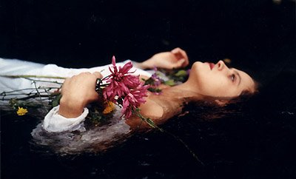
"Alas, then she is drowned."
Discuss how the flower symbolism and imagery associated with Ophelia’s death reveals truths about other characters in the play. Be sure to include at least three specific, cited examples from the text.

Slide 13
"Too much of water hast thou,
poor Ophelia."
Julie Christie as Gertrude in Hamlet (1996, dir. Kenneth Branagh)

