Slide 1
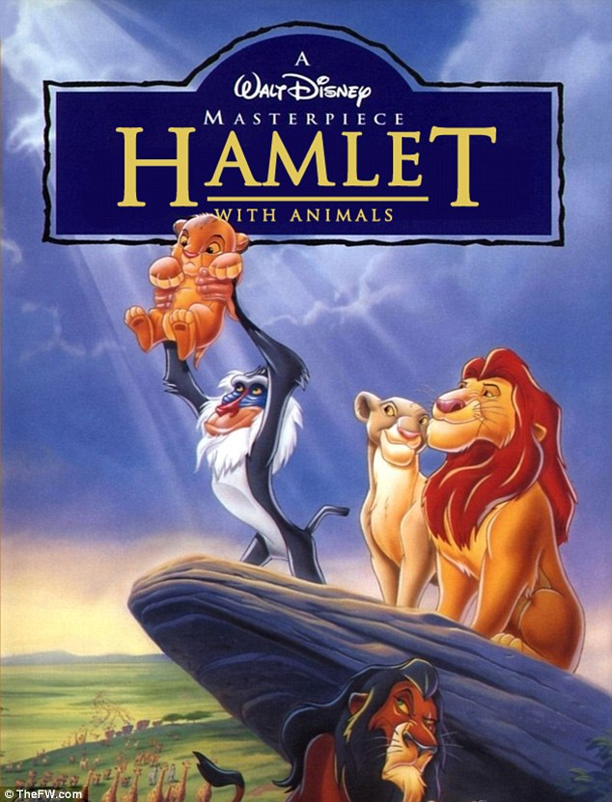
The
Lion King
as a
retelling of
William
Shakespeare’s
Hamlet

Slide 2
Lion King = Hamlet
Yes, the Lion King can be seen as just a simplified retelling of William Shakespeare’s classic play Hamlet

Slide 3
Lion King = Hamlet
(Only without a
happy ending….)

Slide 4
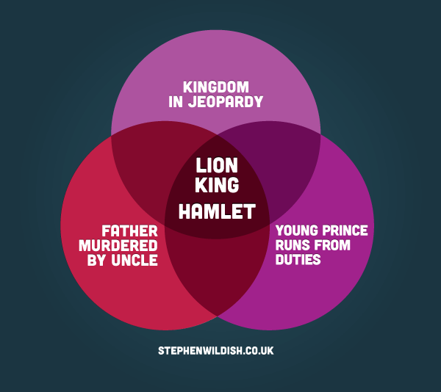
A Simple Venn Diagram

Slide 5
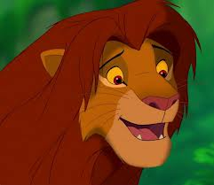
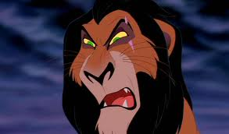
The Characters
Simba = Hamlet
Scar = Claudius

Slide 6
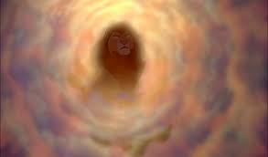
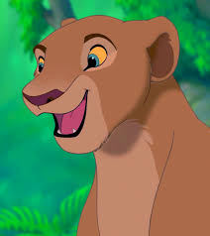
The Characters
Ghost of Mufasa =
Ghost of
King Hamlet
Nala = Ophelia

Slide 7
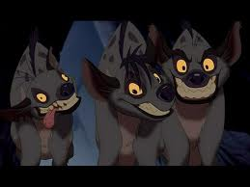
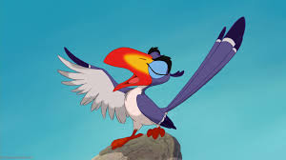
The Characters
Hyenas = Laertes
Zazu = Polonius

Slide 8
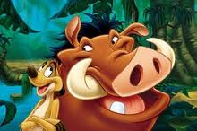
The Characters
Timon & Pumba =
Rosencrantz & Guildenstern

Slide 9
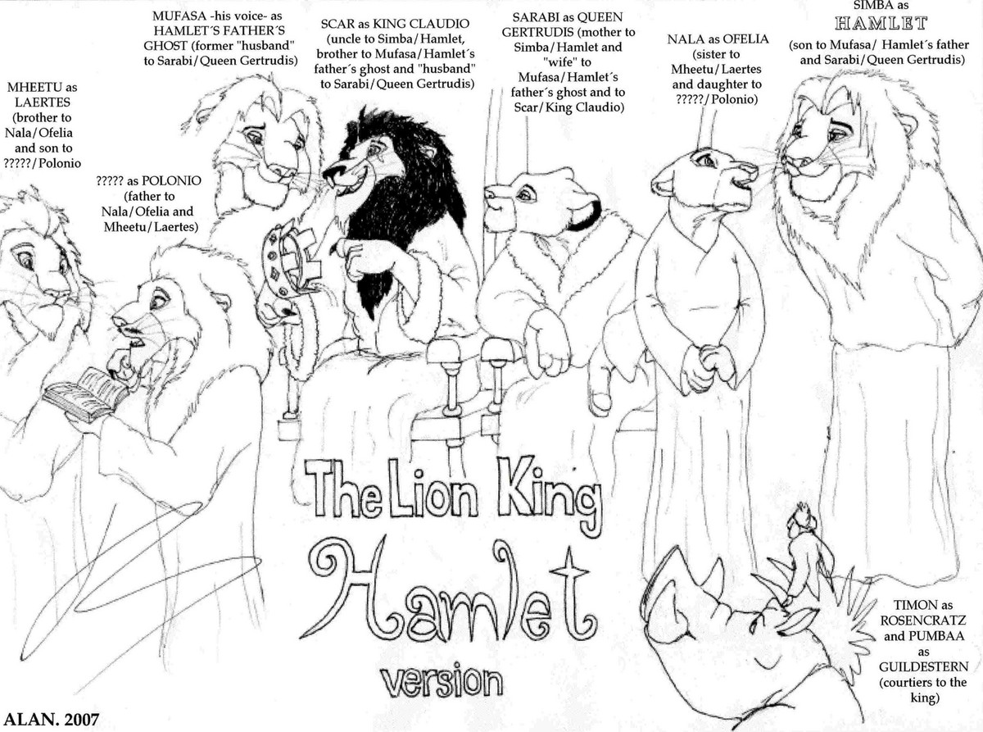

Slide 10
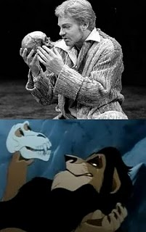
Common Themes
Justice
Loyalty
Relationships
Tragedy
Deceit

Slide 11
The Characters
Simba embodies Hamlet – both are the son of the king and rightful heir to the throne
Mufasa can be compared to Hamlet Senior, who is killed by the uncle figure.
Scar and Claudius are unpleasant, cold, evil uncles.
Laertes, the henchman and right-hand man of Claudius, becomes in the movie, the Hyenas.
The hyenas collectively act as hero-worshipers to Scar, loyal subjects, and fellow doers-in-evil
Rosencrantz and Guilderstern are the comic reliefs in Hamlet, like Timon and Pumba, who live a care-free life.

Slide 12
The Plot
Hamlet and Simba are both betrayed by their uncles whom murder their fathers in order to fulfill their own ambitions.
Both princes delay their decisions to seek vengeance for their murdered fathers.
Each prince runs from their responsibilities after the death of their respective fathers, although they both know what they must do deep inside.

Slide 13
The Plot
Simba escapes reality by running away, while Hamlet escapes by faking madness
Both Mufasa and Hamlet Sr become more than they were in death, encouraging their sons to avenge their deaths
Meanwhile, Claudius/Scar has taken the throne, and married Hamlet/Simba’s mother

Slide 14
The Plot
Scar/Claudius exploits his new-found power and drives his kingdom to war
Scar/Claudius admits that he killed Simba/Hamlet’s father (Though Claudius’s admission is an attempt to repent for his sin, but Scar admits it to boast of his cleverness)

Slide 15
The Plot
Pumbaa & Simon (Rosencrantz & Guilderstern) remind Simba/Hamlet of their responsibility to their father and kingdoms
Sarabi/Gertrude are the queens, and it is their emotional connection to Simba/Hamlet that drive the story.

Slide 16
The Plot
Hamlet is enraged by Gertrude’s marriage to Claudius, and Simba is reminded of his mother when Nala finds him.
When Simba returns to Pride Rock, he is enraged at seeing how Scar is treating his mother, just as Hamlet is enraged at Claudius.

Slide 17
The Plot
Both uncles die – Simba fights Scar, who ends up being killed by hyenas. Hamlet kills his uncle with a sword and poisoned wine

Slide 18
Dialogue
Besides the similarities in characters and plot, dialogue in the Lion King echoes that in Hamlet

Slide 19
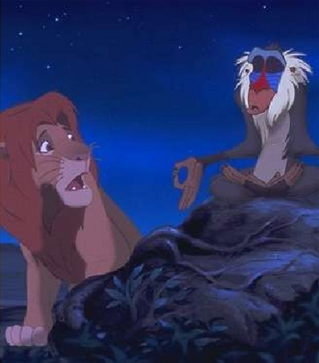
Act I, scene ii
“Correction: I know your father.”
Horatio: “I knew your father. These hands are not more like.”

Slide 20
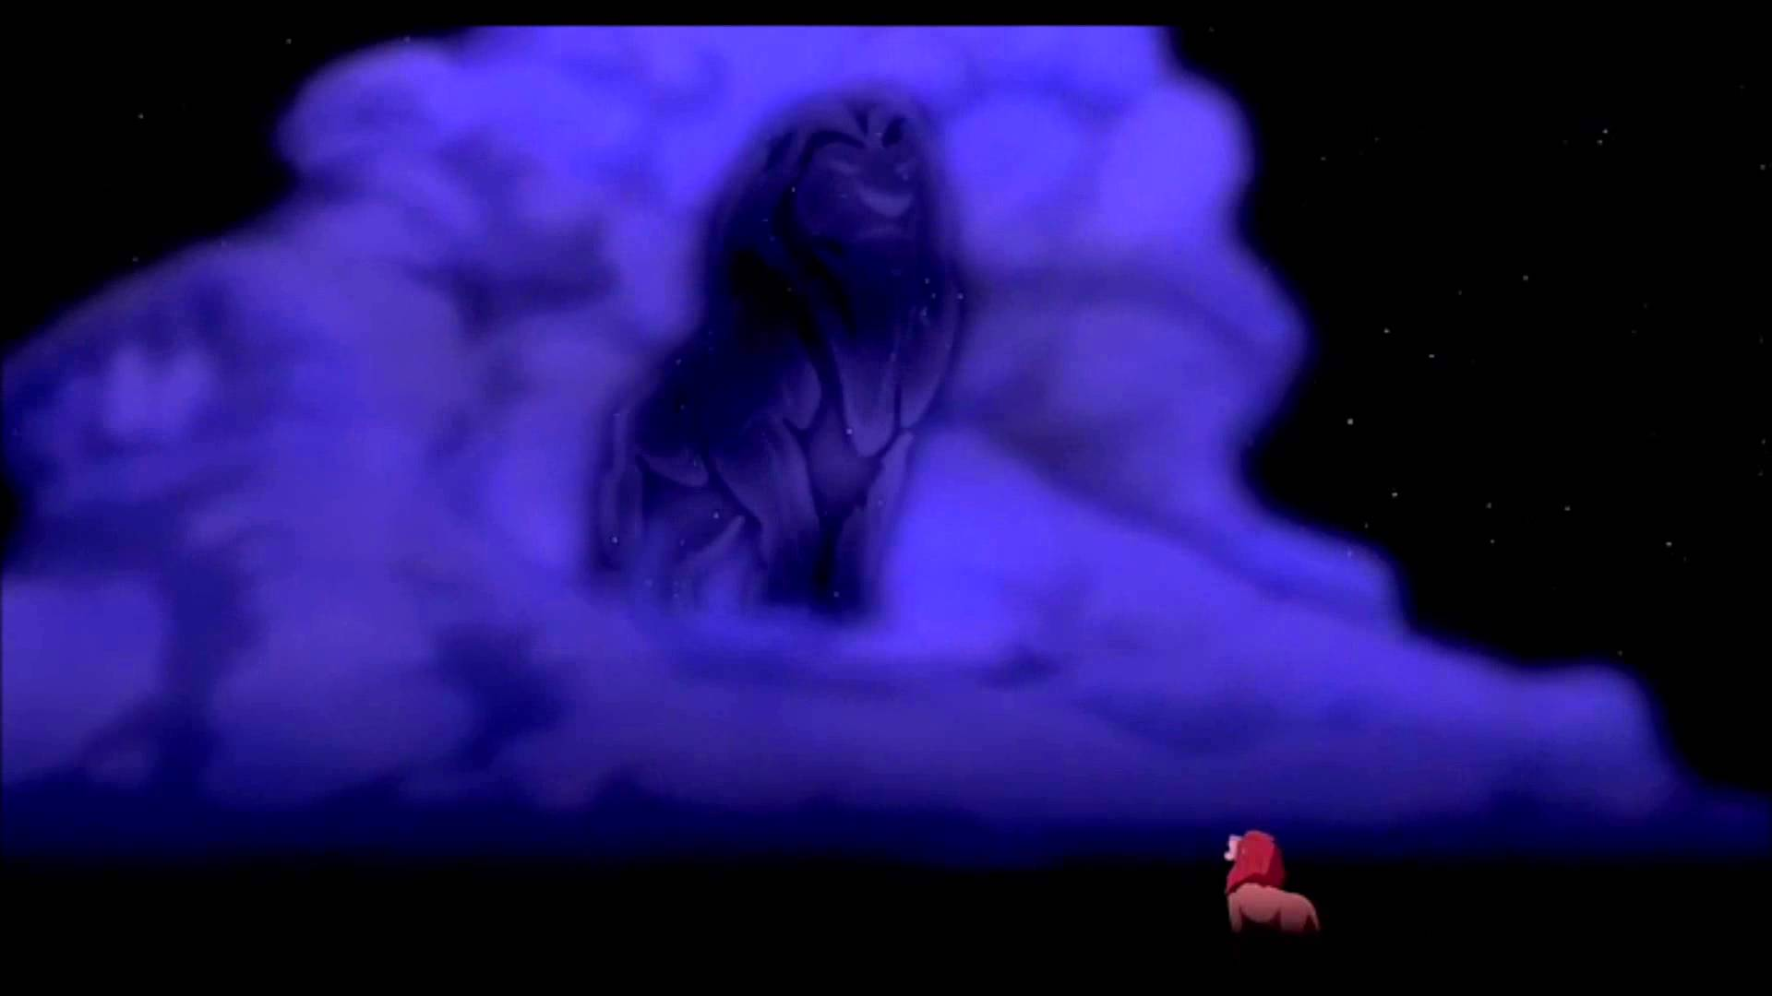
Act I, scene v
Mufasa’s ghost appears to Simba
Hamlet: “Where wilt thou lead me? Speak, I’ll go no further.”

Slide 21
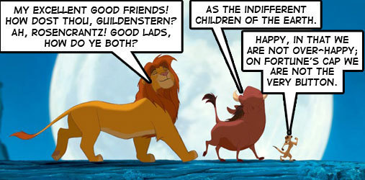
Act II, scene ii
“Hakuna Matata”

Slide 22
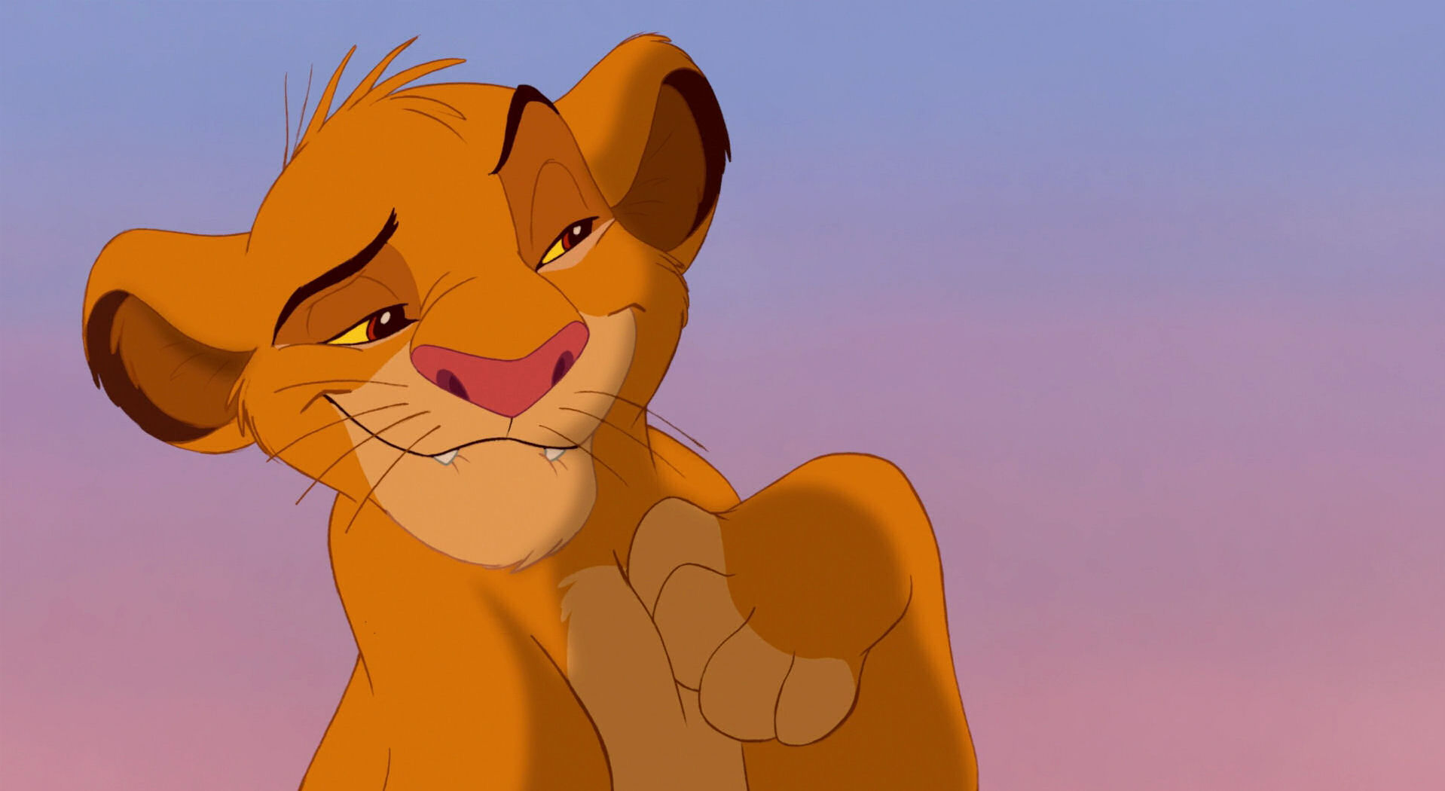
Act II, scene ii
“Yeah…but I pulled it off.”
Hamlet: “The play’s the thing wherein I’ll catch the conscience of the king.”

Slide 23
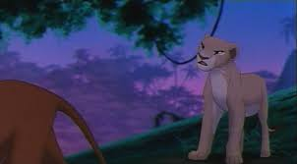
Act III, scene i
Nala is angry with Simba
Hamlet: “Get thee to a nunnery.”

Slide 24
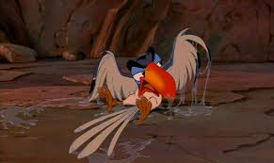
Act III, scene iv
Getting rid of Zazu
Hamlet: “How now a rat? Dead for a ducat, dead.”

Slide 25
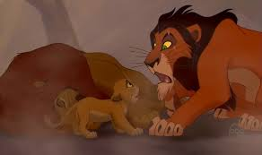
Act IV, scene iii
“Run, Simba. Run away and never return.”
Claudius: “Hamlet, this deed…For what which thou hast done – must send thee hence with fiery quickness….to England.”

Slide 26
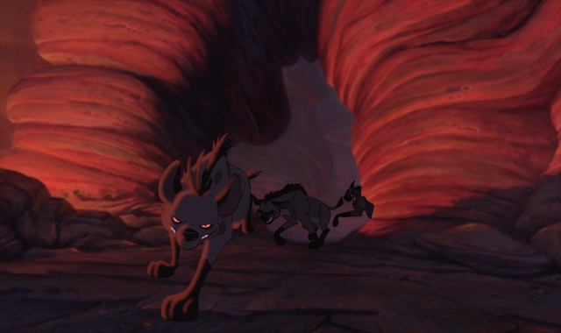
Act IV, scene iii
“Kill him.”
Claudius: “And England…thou mayst not coldly set our sovereign process, which imports at full, by letters congruing to that effect, the present death of Hamlet.”

Slide 27
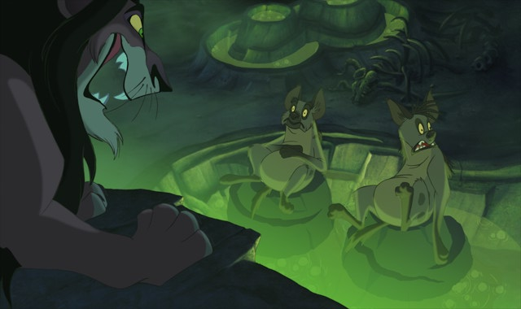
Act IV, scene vii
Plans to kill Simba and Mufasa
Claudius: “If he be now returned, as checking at his voyage, and that he means no more to undertake it, I will work him to an exploit, now ripe in my devise, under which he shall not choose but fall.”

Slide 28
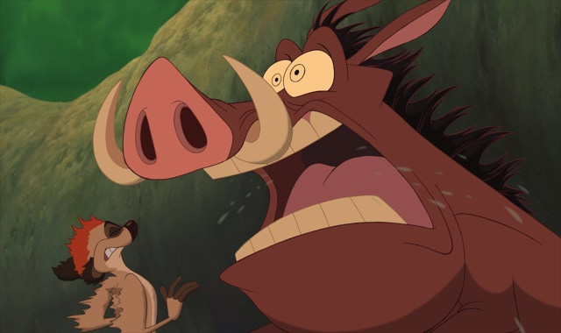
Act V, scene ii
“She’s gonna eat me!”
Hamlet: “He should the bearers put to sudden death, not shriving time allowed.”

Slide 29
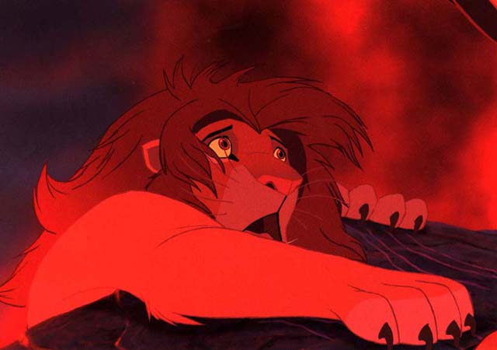
Act V, scene ii
“This looks familiar.”
Laertes: “It is here, Hamlet. Hamlet, thou art slain. No medicine in the world can do thee good.”

Slide 30
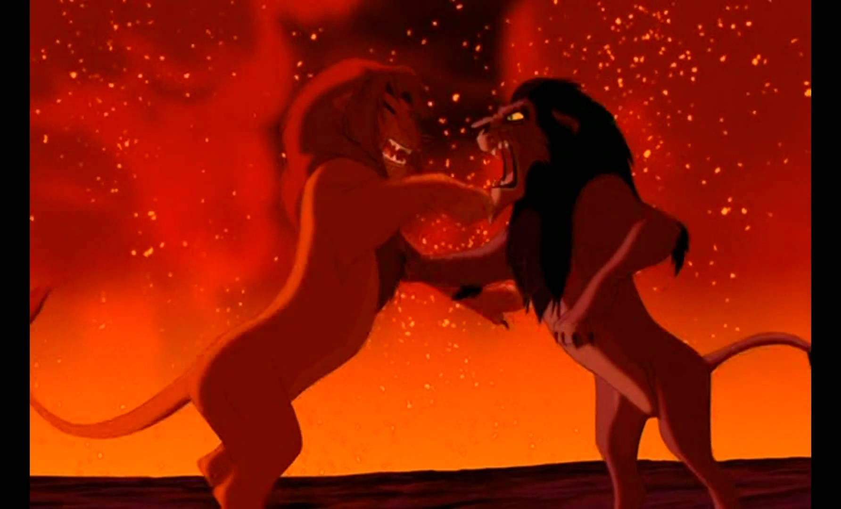
Act V, scene ii
Simba fights Scar
Hamlet: “Here, thou incestuous, murderous, damned Dane, drink off this potion. Is thy union here? Follow my mother.”

Slide 31
But…..
The Disney version is happier and more kid-friendly. Otherwise you’d have these disturbing memories of the film:
Remember when Nala murdered herself by walking into that lake?
Remember at the end when Timon and Pumba are seen hanging from a ship's mast?
That whole scene in Lion King where the player Zebras come and act out how Scar killed Mufasa.
All the backstabbing poisoning at the end of the movie?
Remember how Fortinbras the Flamingo actually becomes the king?

