Slide 1
Women in Heart of Darkness

Slide 2
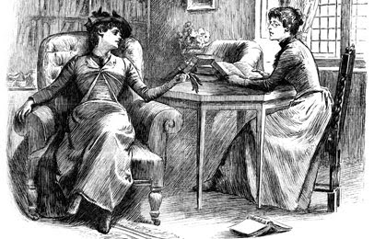
Women in HOD
What is the role of women in Heart of Darkness?
Marlow’s Aunt
The Knitting women
Kurtz’s African Mistress
Kurtz’s intended

Slide 3
Role of Women
Civilization exploitive of women
Civilization as a binding and self-perpetuating force

Slide 4
Women as a Symbol
Marlow believes that women exist in a world of beautiful illusions that have nothing to do with truth or the real world.
Women, therefore, come to symbolize civilization’s ability to hide its hypocrisy and darkness behind pretty ideas.

Slide 5
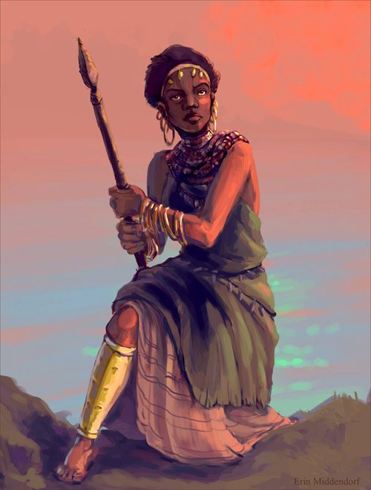
The Barbarian Mistress
Pages 55-6
See annotation handout
Page 62 (to note for your writing)
“I pulled the string of the whistle…At the sudden screech there was a movement of abject terror through that wedged mass of bodies…They broke and ran…Only the barbarous and superb woman did not so much as flinch, and stretched tragically her bare arms after us over the somber and glittering river.”

Slide 6
Annotation- you will need 3 different colors.
Read the excerpts for comprehension without annotation.
Annotate for what you think is important.
Annotate for how Marlow reveals the character of each, considering tone, imagery, diction.
Annotate for possible thematic connections. What does the character reveal about the novel as a whole?

Slide 7
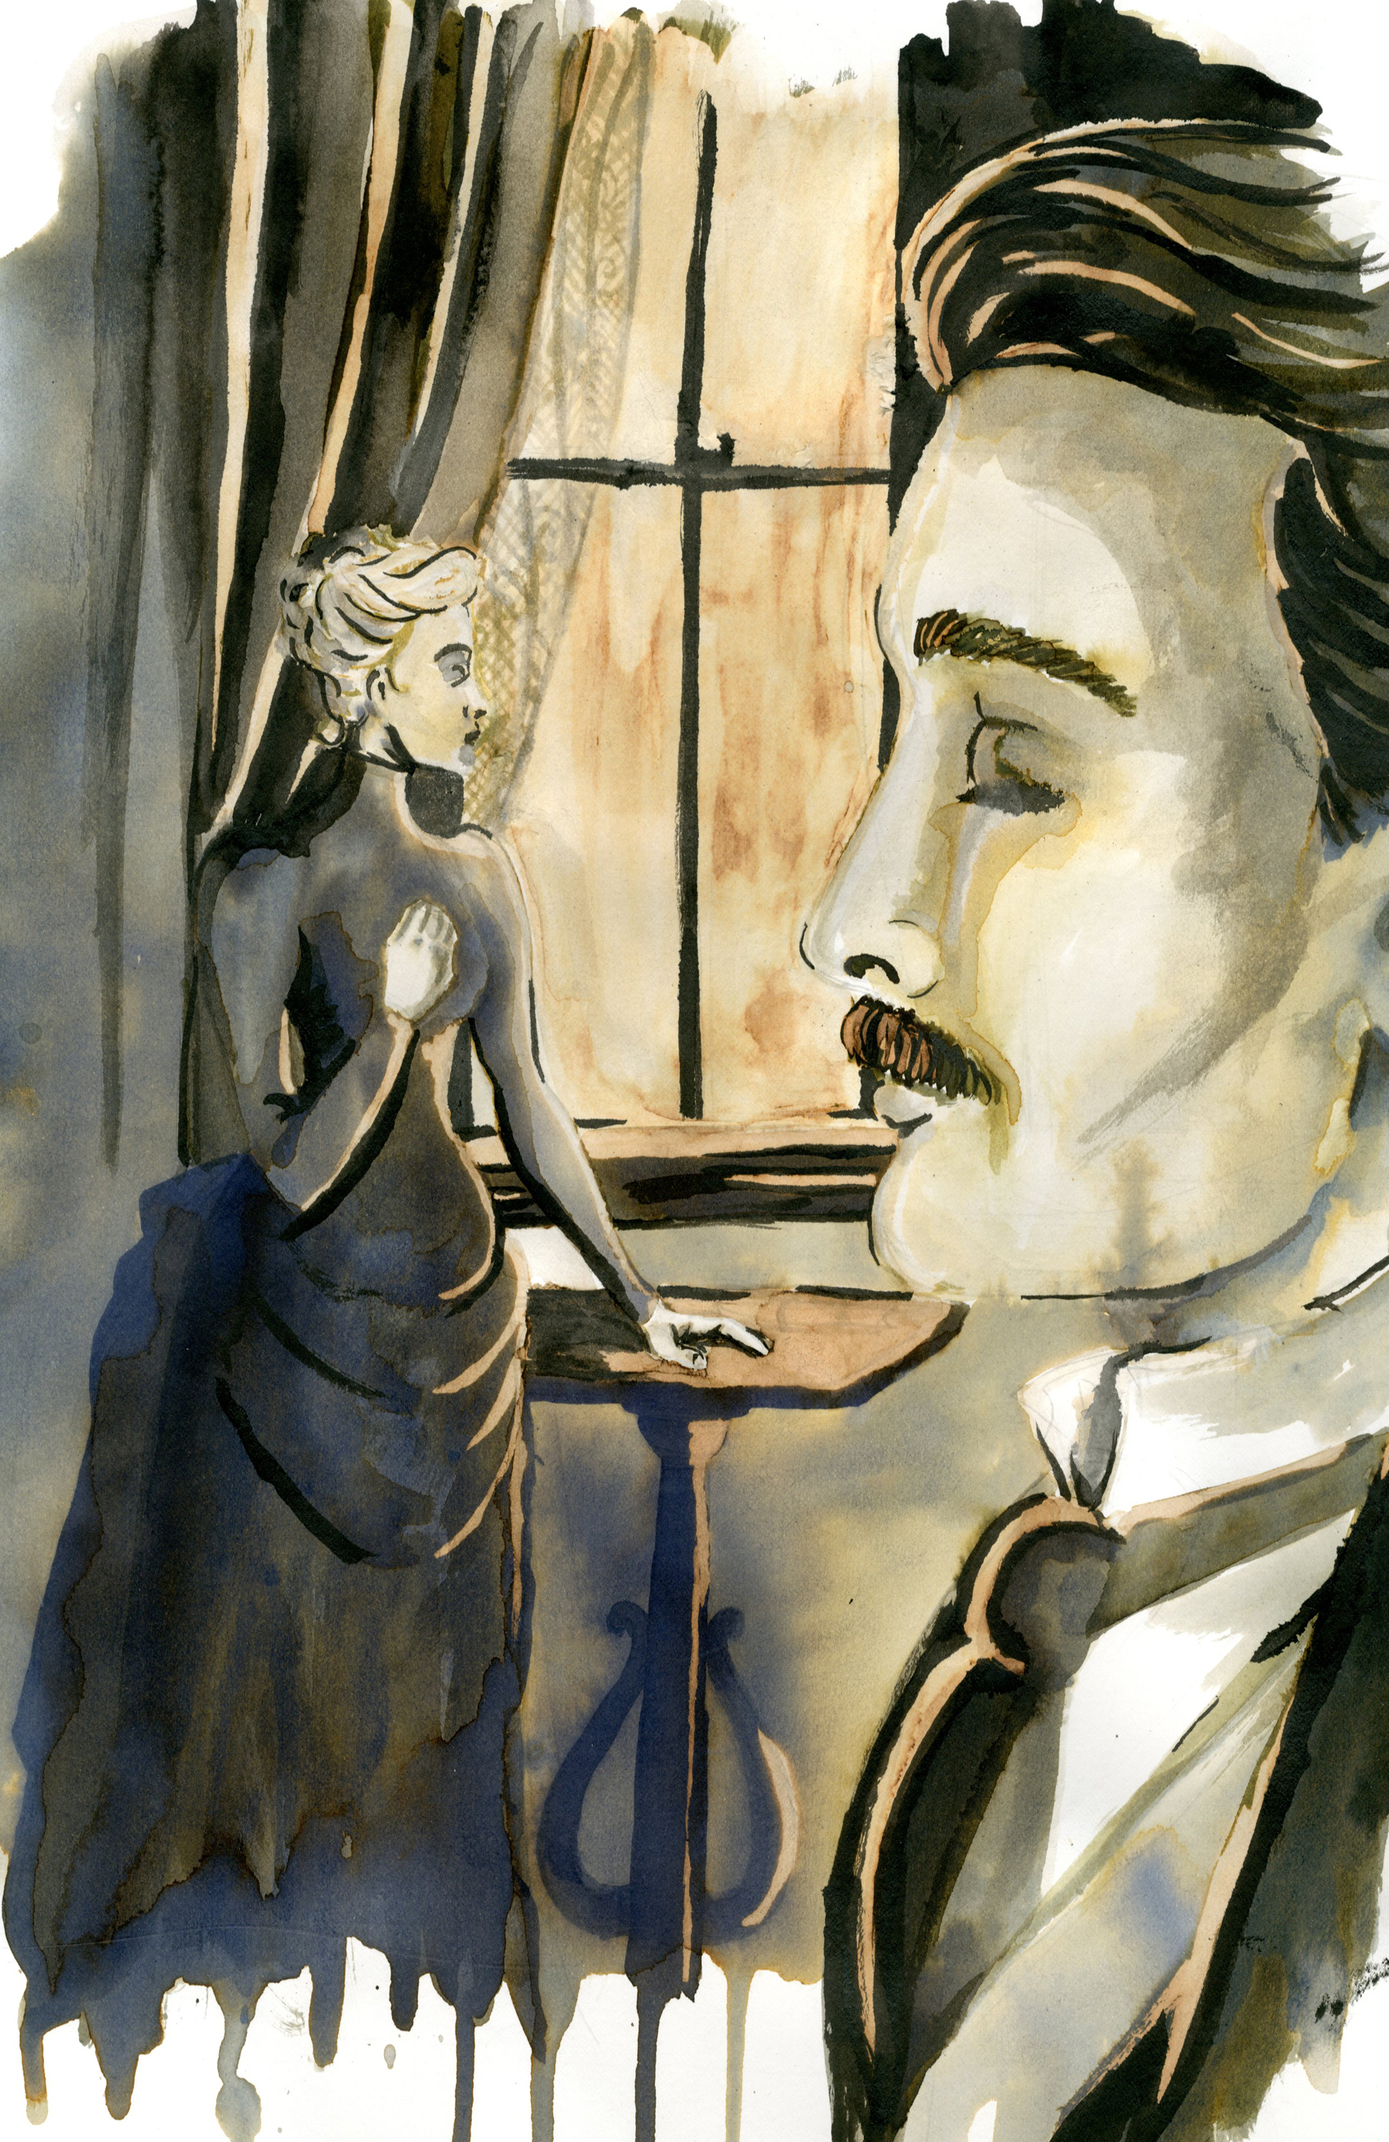
The Intended
Pgs. 68- End of Work
See annotation handout.
See novel.

Slide 8
Annotation- you will need 3 different colors.
Read the excerpts for comprehension without annotation.
Annotate for what you think is important.
Annotate for how Marlow reveals the character of each, considering tone, imagery, diction.
Annotate for possible thematic connections. What does the character reveal about the novel as a whole?

Slide 9
Relook at BOTH texts- You will need a new color.
Annotate for similarities and differences between the Mistress and the Intended.

Slide 10
Compare and Contrast
Compare and contrast Kurtz’s Native Mistress with his Intended.
How does Marlow reveal the character of each in your close reading passages? Consider such literary elements as imagery, diction, tone, point of view, etc.
How does this contrast impact the novel as a whole? Consider theme, motif, character (of Kurtz) and symbolism.

Slide 11
Literary Criticism

Slide 12
Chinua Achebe’s Critique
The kind of liberalism espoused here by Marlow/Conrad touched all the best minds of the age in England, Europe, and American. It took different forms in the minds of different people but almost always managed to sidestep the ultimate question of equality between white people and black people. . .
The point of my observations should be clear by now, namely, that Conrad was a blood racist.

Slide 13
Chinua Achebe’s Critique
And the question is whether a novel which celebrates this dehumanization, which depersonalizes a portion of the human race, can be called a great work of art. My answer is: No, it cannot.
I would not call that man an artist, for example, who composes an eloquent instigation to one people to fall upon another and destroy them. No matter how striking his imagery or how beautiful his cadences fall such a man is no more a great artists than another may be called a priest who reads the mass backwards or a physician who poisons his patients. All those men in Nazi Germany who lent their talent to the service of virulent racism whether in sciences, philosophy or the arts have generally been condemned for their perversions. The time is long overdue for taking a hard look at the work of creative artists who apply their talents, alas often considerable as in the case of Conrad, to set people against people.

Slide 14
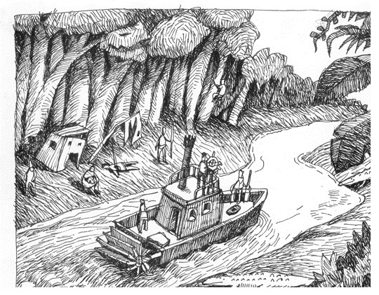
Written Response
Respond to Achebe’s critique. Back any opposing arguments, claims, or agreements with evidence from the text.

