Slide 1
“Blue Beard”
Grimms Fairytale Classics

Slide 2
Once upon a time. . .

Slide 3
A month or so later. . .

Slide 4
The days went by. . .

Slide 5
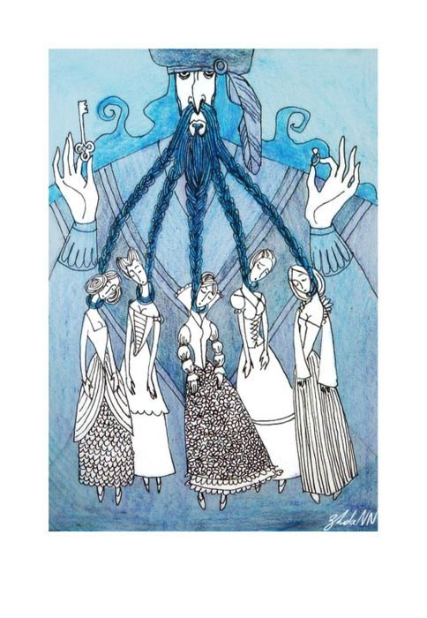
She opened the door and walked into the little room. . .

Slide 6
Blue Beard turned white and in a deep hoarse voice demanded. . .

Slide 7
Blue Beard was clutching a big knife. . .

Slide 8
Two young men burst into the room. . .

Slide 9
That was the end. . .

Slide 10
Jane Eyre Summary

Slide 11
Chapters 1-4:
Setting: Gateshead with the Reed family
Characters: Jane, Aunt Reed, John, Eliza, Georgiana, Bessie, Mr. Lloyd, Mr. Brocklehurst
Major Events:
Jane is living with the Reeds
They punish her by putting her in the red room but then she faints so they must call the doctor (Mr. Lloyd)
Mr. Brocklehurst comes and meets Jane and allows her to come to his school

Slide 12
Chapters 5-10
Setting: Lowood School
Characters: Miss Temple and Helen
Major Events:
Jane comes to Lowood and realizes what life at Lowood is going to be like
She meets Helen and Miss Temple
Mr. Brocklehurst visits and ruins Jane’s reputation by calling her a liar
Miss Temple helps clear Jane’s name
Helen gets really sick and dies
Fast forward, Jane has been at Lowood 8 years- 6 as a student, 2 as a teacher- and decides to advertise herself to go somewhere new

Slide 13
Chapters 11-15
Setting: Thornfield Mansion
Characters: Miss Fairfax, Adele, Grace Poole, Mr. Rochester
Major Events:
Jane arrives at Thornfield mansion and meets everyone/gets a tour/hears a creepy laugh
Jane goes out walking and runs into Mr. Rochester and finds him injured
Jane and Rochester have many conversations and she eventually learns the story behind Adele
Jane saves Rochester from the fire

Slide 14
What is a Bildungsroman??

Slide 15
Character Analysis
There will be 4 groups and each will begin at one character table.
They will have 10-12 minutes to complete that character analysis.
Once the 10 minutes is up, each group will rotate to the next table to continue on in the next character analysis

Slide 16
Exit Ticket
In a bildungsroman novel, relationships in the main character’s life shape them in very impactful ways. Think about the characters Jane has relationships with so far in the novel. In your opinion, which relationship has had the most impact on Jane’s character and why she is the way that she is?
Examples of characers:
Rochester
Bessie
Miss Temple
Miss Fairfax
Helen
Mr. Brocklehurst
Aunt Reed
John Reed

