Slide 1
Jane eyre and autonomy

Slide 2
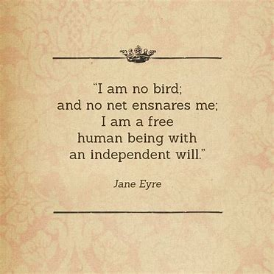
Definition of Autonomy
Independence or freedom, as of the will or one’s actions; morally independent
Jane has fear of losing her autonomy and so she runs away from Rochester.
The condition of being autonomous; self-government or the right of self-government.
The rebels demanded autonomy from Spain.

Slide 3
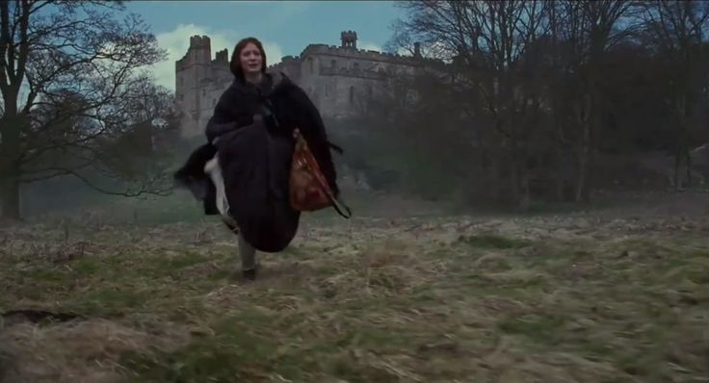
Thornfield/ Pre-Moor House
What does Jane do in fear of losing her autonomy?

Slide 4
Moor House----Brainstorm
Why is Moor House such an important phase for Jane?
What does she gain from Moor house that impacts her identity or her social class?
How is Jane’s autonomy tested?
Passion vs. logic

Slide 5
Creative Writing Exit Ticket
Write a journal entry from Jane’s perspective discussing one of the ways her time at Moor House impacted her life.
How has her identity changed or been reinforced because of this?
How will her life look different now?
**Write at least half a page

