Slide 1
HOW TO MAKE RESEARCH NOTECARDS (Paper) (See handout for digital notecards)

Slide 3
Notecard Notes
Each notecard will contain about one sentence of paraphrased information from a source.
ALL NOTES MUST BE IN YOUR OWN WORDS!
Each notecard must include the source number (e.g. which source that note came from), the subject matter of the notecard, and the page number (when applicable).
If a source does not have page numbers, such as a website, you may omit the page number from your notecard.
The purpose of notecards is to organize your research by source so that you can parenthetically cite your sources in your paper.
Don’t forget any component of your notecard, or you will have difficulty citing your sources in your research paper.

Slide 4
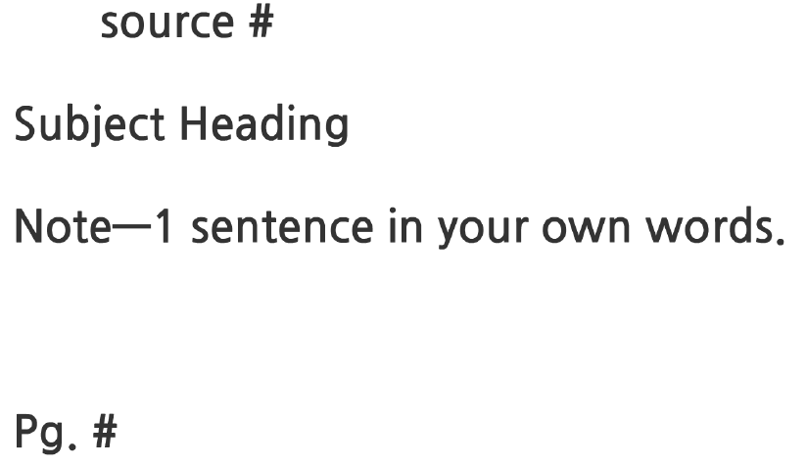
Notecard Format

Slide 6
Source Number (where the note came from)
Subject of Notecard
ONE to TWO sentences of paraphrased notes
Page number

Slide 7
ALSO ACCEPTABLE EXAMPLE
Source Number (where the note came from)
Source: Encyclopedia Britannica
History
Accounting began long ago in the Middle East and Central America by people called scribes.
Page 23
Subject of Notecard
ONE to TWO sentences of paraphrased notes
Page number

Slide 8
HOW TO MAKE RESEARCH SOURCE CARDS

Slide 10
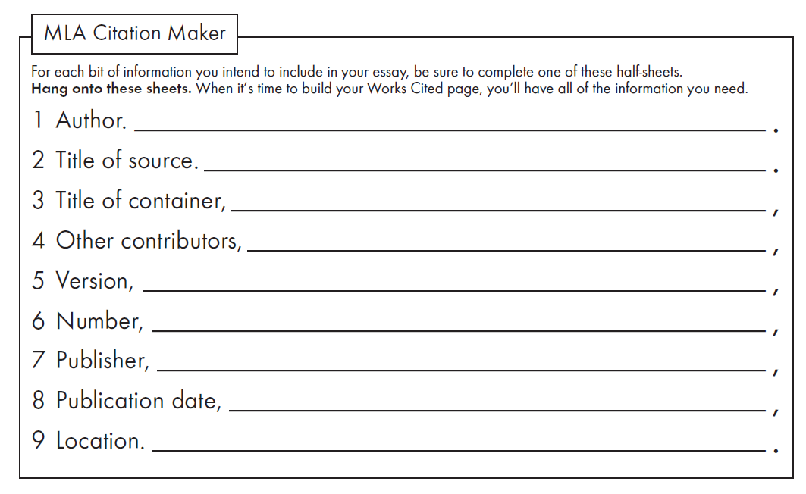
Source Card Notes
You will use your citation maker sheets to keep track of all of your sources, and you will document them on your works cited page.
You will use your source cards to create your works cited page which must house EVERY SOURCE that you use in your paper.
You are responsible for assigning your own source number to each of your citation maker entries.
You may keep source cards digitally instead.
ADD A SOURCE NUMBER HERE
Source #1

Slide 12
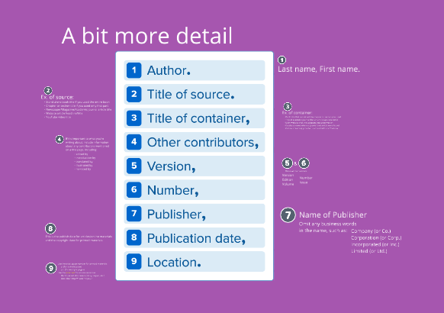

Slide 15
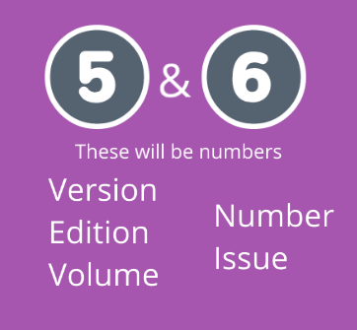
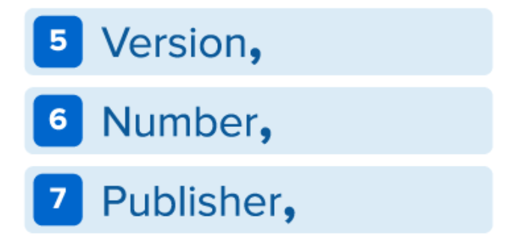

Slide 16
