Slide 1
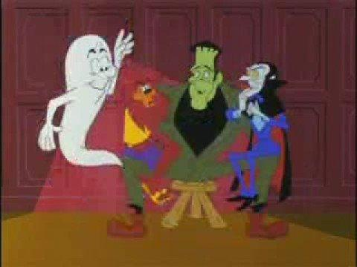

Slide 2
Villanelle

Slide 3
Villanelle
The highly structured villanelle is a nineteen-line poem with two repeating rhymes and two refrains. The form is made up of five tercets followed by a quatrain. The first and third lines of the opening tercet are repeated alternately in the last lines of the succeeding stanzas; then in the final stanza, the refrain serves as the poem’s two concluding lines. Using capitals for the refrains and lowercase letters for the rhymes, the form could be expressed as: A1 b A2 / a b A1 / a b A2 / a b A1 / a b A2 / a b A1 A2.

Slide 4
Villanelle
Strange as it may seem for a poem with such a rigid rhyme scheme, the villanelle did not start off as a fixed form. During the Renaissance, the villanella and villancico (from the Italian villano, or peasant) were Italian and Spanish dance-songs. French poets who called their poems “villanelle” did not follow any specific schemes, rhymes, or refrains. Rather, the title implied that, like the Italian and Spanish dance-songs, their poems spoke of simple, often pastoral or rustic themes.

Slide 5
Villanelle
While some scholars believe that the form as we know it today has been in existence since the sixteenth century, others argue that only one Renaissance poem was ever written in that manner--Jean Passerat’s “Villanelle," or “J’ay perdu ma tourterelle”--and that it wasn’t until the late nineteenth century that the villanelle was defined as a fixed form by French poet Théodore de Banville.
Regardless of its provenance, the form did not catch on in France, but it has become increasingly popular among poets writing in English.

Slide 6
“Do Not Go Gentle Into That Good Night” by Dylan Thomas
Do not go gentle into that good night,
Old age should burn and rave at close of day;
Rage, rage against the dying of the light.
Though wise men at their end know dark is right,
Because their words had forked no lightning they
Do not go gentle into that good night.
Good men, the last wave by, crying how bright
Their frail deeds might have danced in a green bay,
Rage, rage against the dying of the light.
Wild men who caught and sang the sun in flight,
And learn, too late, they grieved it on its way,
Do not go gentle into that good night.
Grave men, near death, who see with blinding sight
Blind eyes could blaze like meteors and be gay,
Rage, rage against the dying of the light.
And you, my father, there on the sad height,
Curse, bless, me now with your fierce tears, I pray.
Do not go gentle into that good night.
Rage, rage against the dying of the light.

Slide 7
“One Small Bite” by Dillon Rorie
It only takes one small bite,
Young or old, it does not matter;
For at the end, you will not win the fight.
From the ground they came, a new blight;
Their clothes and skin were nothing but tatter
It only takes one small bite.
As the news spread, people began to take flight
The people had wished it was nothing but chatter
For at the end, you will not win the fight.
Their eyes, blank and milky white
They won’t die, even if their bones shatter
It only takes one small bite.
Your soon begin your final plight,
They bite into your loved ones, blood splatter
For at the end, you will not win the fight.
Everything around you becomes dark as night
Your bones ache and teeth start to chatter
It only takes one small bite,
For at the end, you will not win the fight.

Slide 8
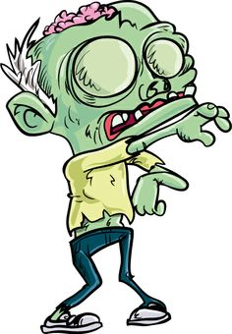

Slide 9
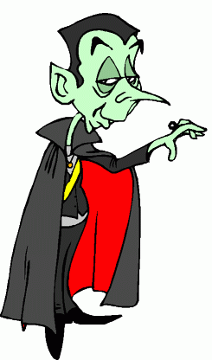

Slide 10
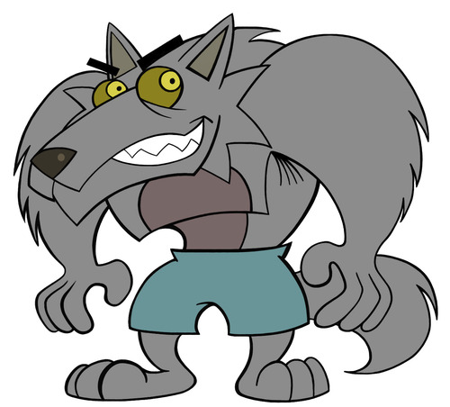

Slide 11
